Slide 1




Patient Simulation

Slide 2
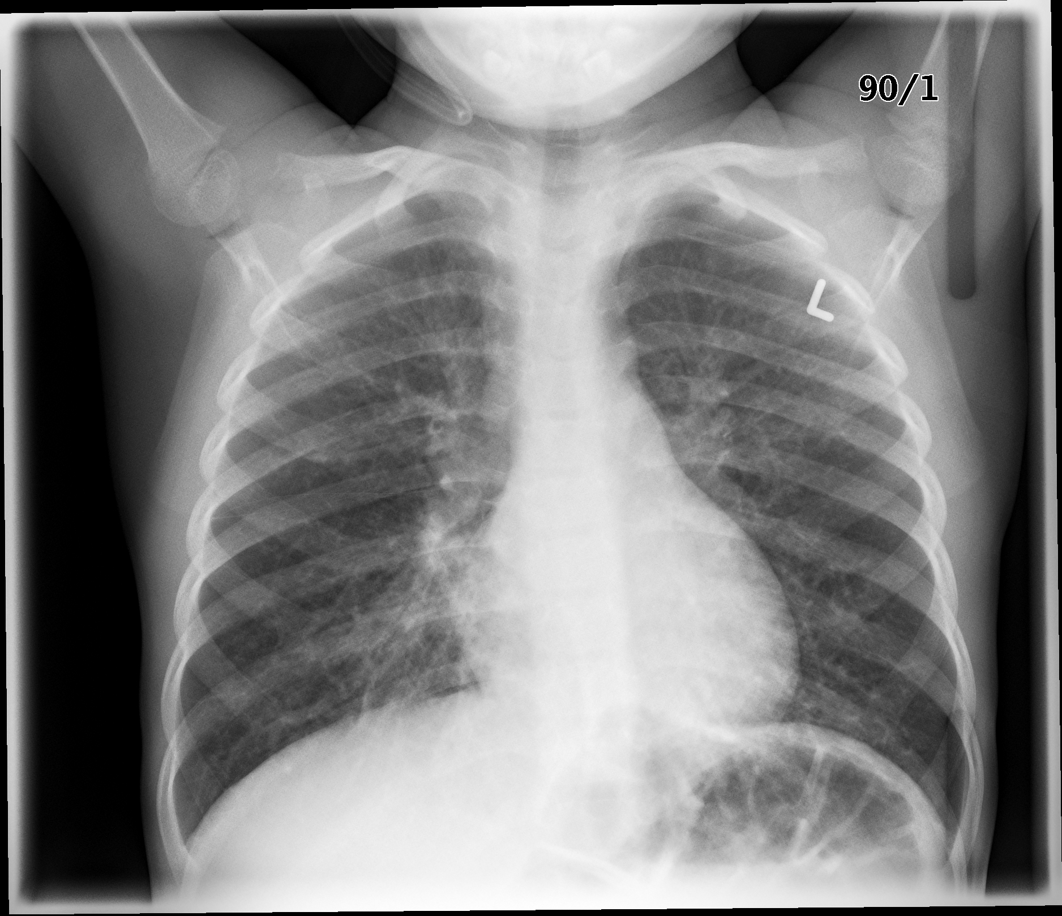

Slide 3
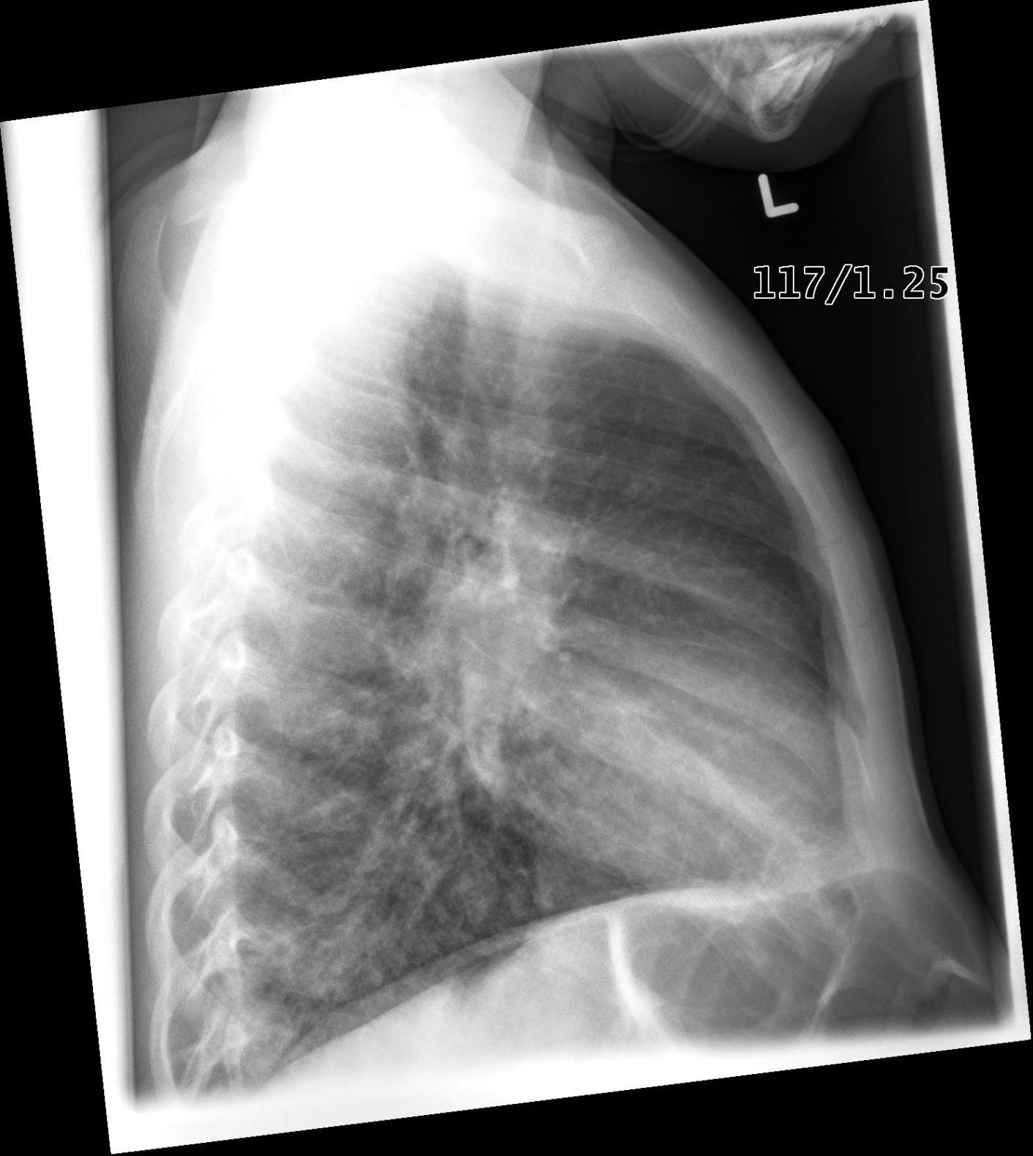

Slide 4
Bloodwork
Test | DATE/TIME here | Flag (H or L) | Reference
CBC
WBC | 16.7 | H | 3.5 – 10.8 10^9/L
Hgb | 120 | L | 130 – 170 g/L
Platelets | 250 |  | 150 – 400 10^9/L
Chemistry
Na | 118 | L | 137 – 145 mmol/L
K | 9.5 | H | 3.5 – 5.0 mmol/L
Urea | 6.0 |  | 2.5 – 6.1 mmol/L
Creat | 80 |  | 62 – 106 umol/L
Glucose - Random | 1.0 | L | 3.0 – 11.0 mmol/L
Lactate | 7.8 | H | 0.9 – 1.8 mmol/L
ABGs
Arterial
pH | 6.99 | L | 7.35- 7.45
pCO2 | 15 | L | 35 – 45 mmHg
PO2 | 60 | L | 80-100 mmHg
BE | -20 | L | -2.0 to +2.0 mmol/L
HCO3 | 5 | L | 22 – 26 mmol/L
O2 Sat |  |  | 95 – 100%

Slide 5
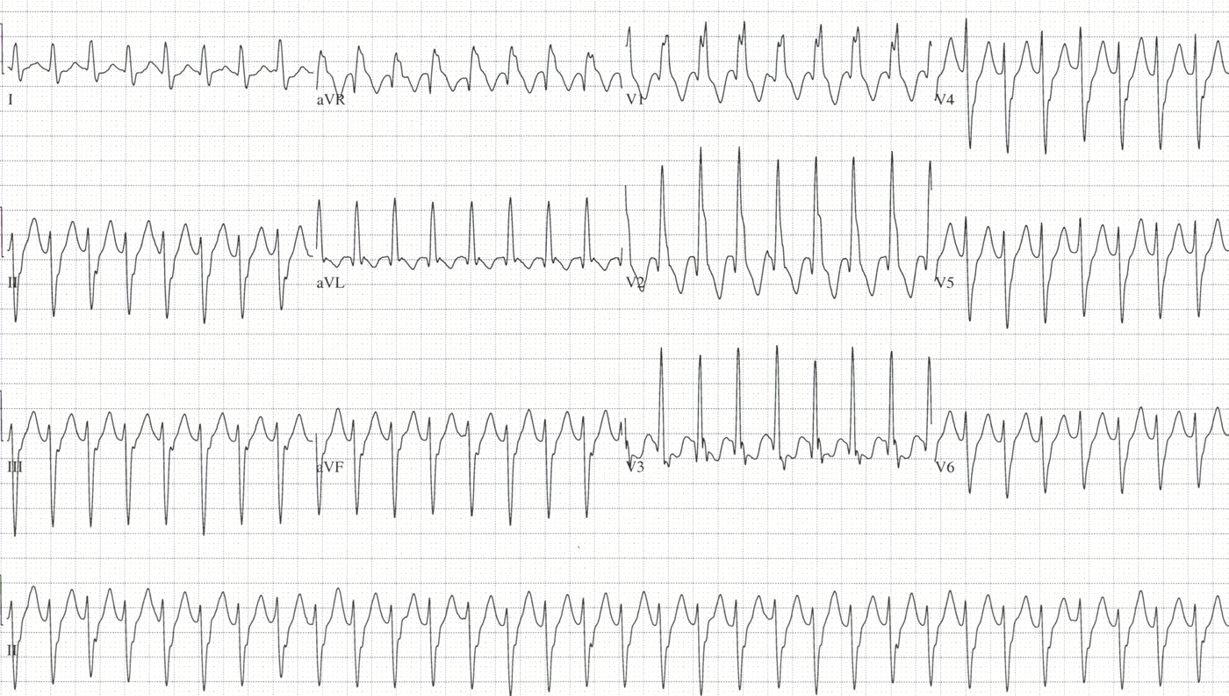

Slide 6
