Slide 1




Patient Simulation

Slide 2
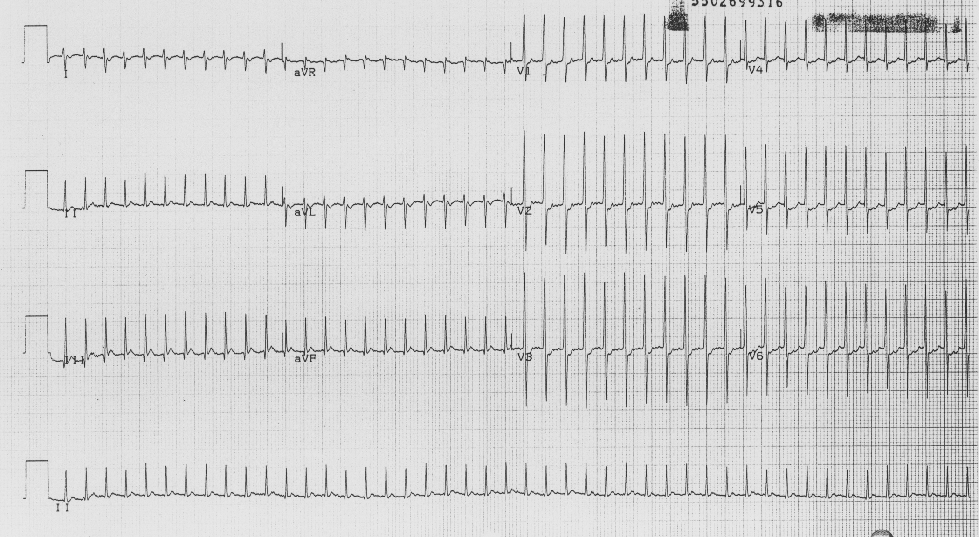

Slide 3
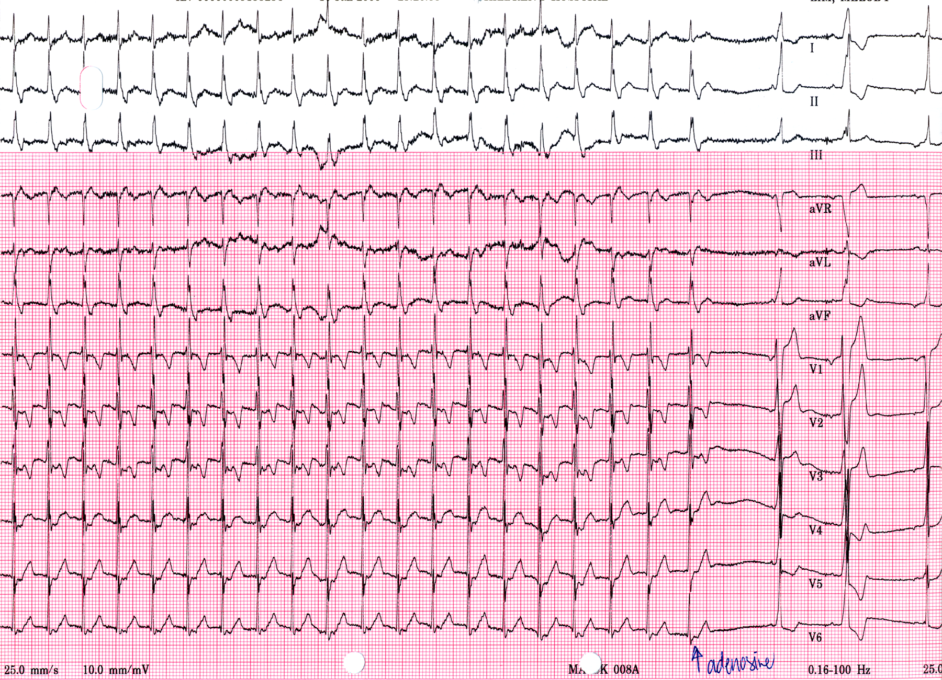

Slide 4
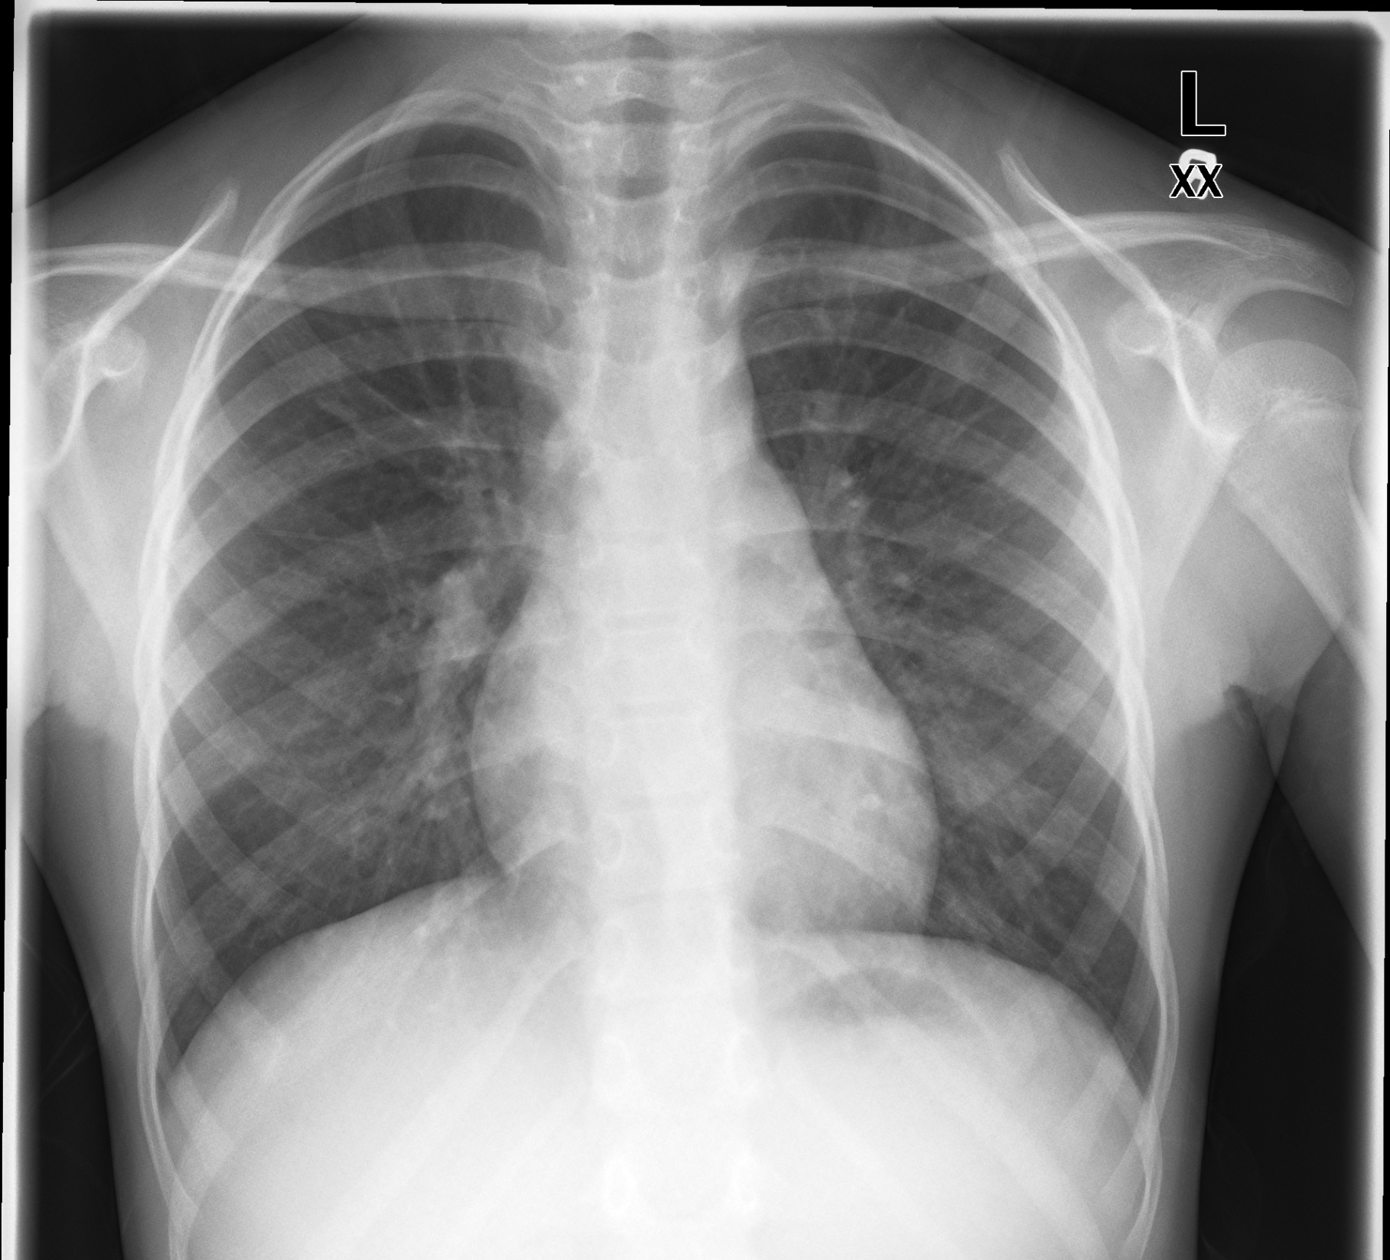

Slide 5
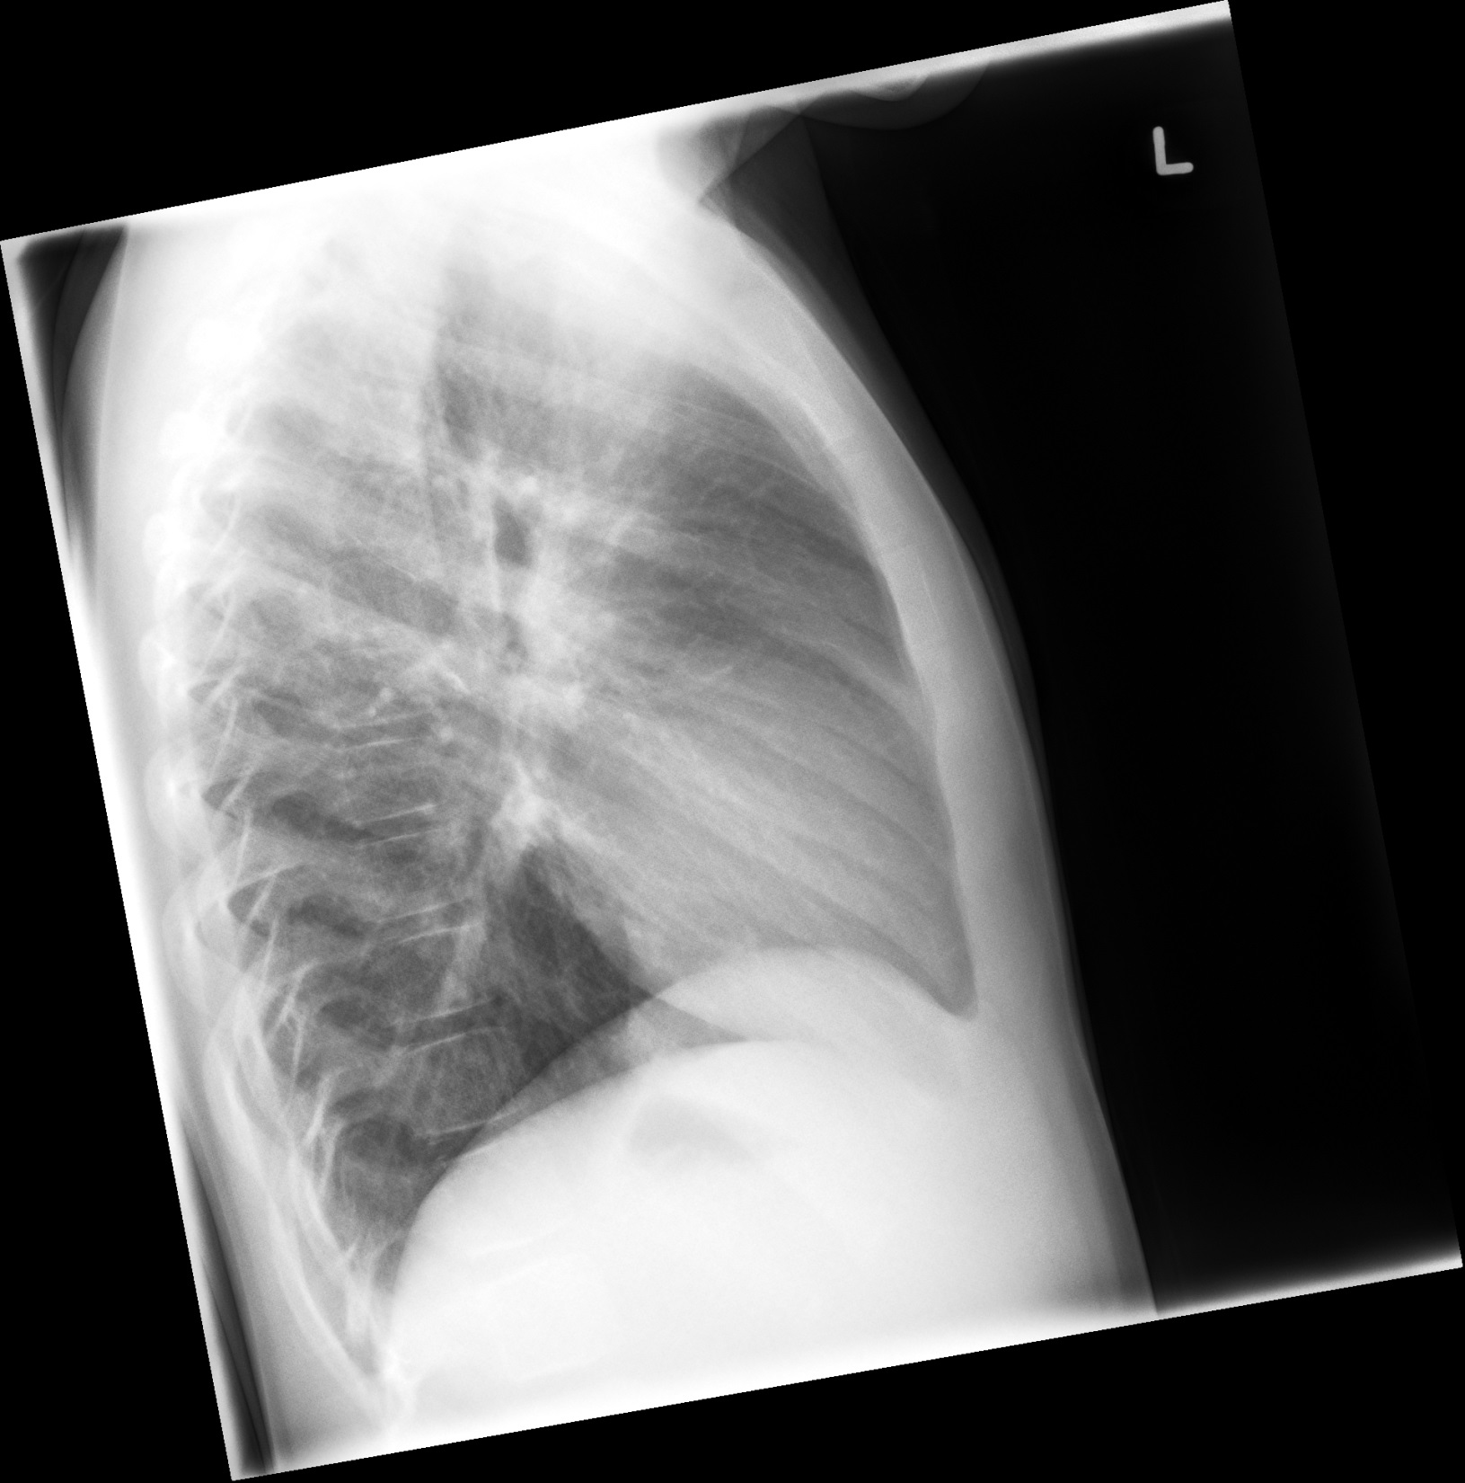

Slide 6
Bloodwork
Test | DATE/TIME here | Flag (H or L) | Reference
CBC
WBC | 14.7 | H | 3.5 – 10.8 10^9/L
Hgb | 130 | L | 130 – 170 g/L
Platelets | 250 |  | 150 – 400 10^9/L
Chemistry
Na | 138 |  | 137 – 145 mmol/L
K | 4.5 |  | 3.5 – 5.0 mmol/L
Cl | 109 |  | 98 – 107 mmol/L
Urea | 3 |  | 2.5 – 6.1 mmol/L
Creat | 30 |  | 62 – 106 umol/L
Glucose - Random | 4.0 |  | 3.0 – 11.0 mmol/L

