Slide 1




Patient Simulation

Slide 2
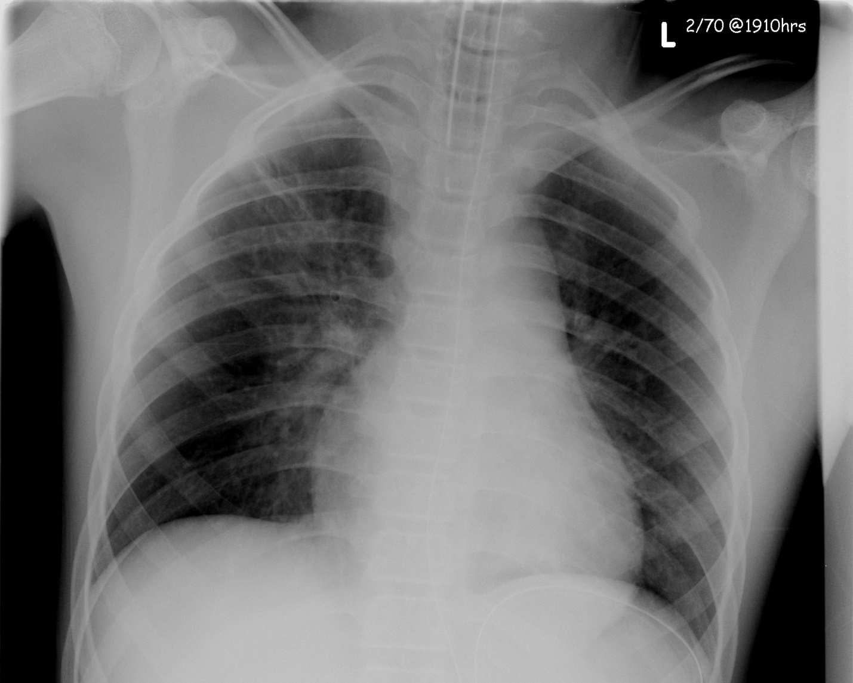

Slide 3
Test | Phase 2 | Flag (H or L) | Reference
CBC
WBC | 25 | H | 3.5 – 10.8 10^9/L
Neutrophils | 18.3
Chemistry
Na | 135 | L | 137 – 145 mmol/L
K | 4.5 |  | 3.5 – 5.0 mmol/L
Cl | 109 |  | 98 – 107 mmol/L
Urea | 6.4 | H | 2.5 – 6.1 mmol/L
Creat | 24 | L | 62 – 106 umol/L
Glucose - Random | 2.6 | L | 3.0 – 11.0 mmol/L
ABGs
Arterial
pH | 7.38 |  | 7.35- 7.45
pCO2 | 45 |  | 35 – 45 mmHg
PO2 | 90 |  | 80-100 mmHg
BE | -2 |  | -2.0 to +2.0 mmol/L
HCO3 | 23 |  | 22 – 26 mmol/L
O2 Sat |  |  | 95 – 100%

