Slide 1
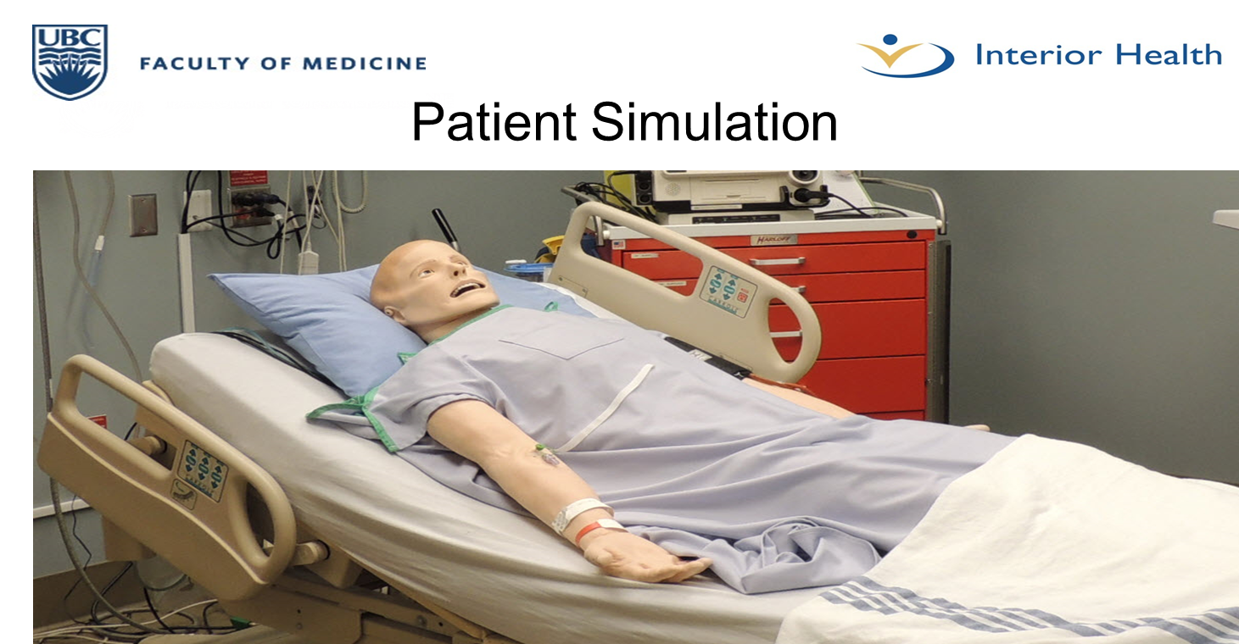

Slide 2


Slide 3
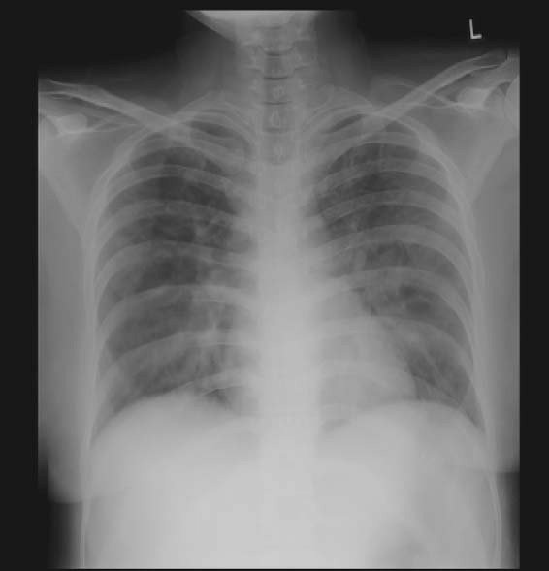

Slide 4
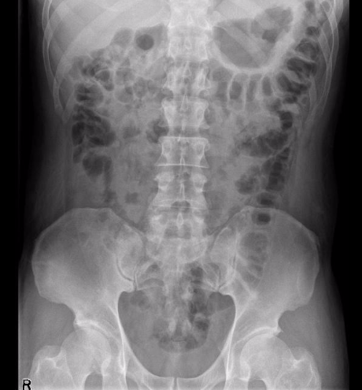

Slide 5
CBC WBC 16 Hgb 110 Plt 90 Lytes Na 140 K 4.5 Cl 110 HCO₃ 14 AG Urea 10 Cr 370 Glucose 4.5 Extended Lytes NOT DONE Ca Mg PO₄ Albumin TSH VBG pH 7.23 pCO₂ 40 pO₂ 30 HCO₃ 12 Lactate 5 | Cardiac/Coags Trop 40 D-dimer 1000 INR 1.4 aPTT 37 Biliary- NORMAL PANEL AST ALT GGT ALP Bili Lipase Tox NOT DONE EtOH ASA Tylenol Dig level Osmols Other B-HCG: Negative

Slide 6

Evaluation
simulation.interiorhealth.ca
Scan QR code
OR
Type the above into your browser and select
“Fixed Centre Simulation Evaluation Form”

