Slide 1




Patient Simulation

Slide 2
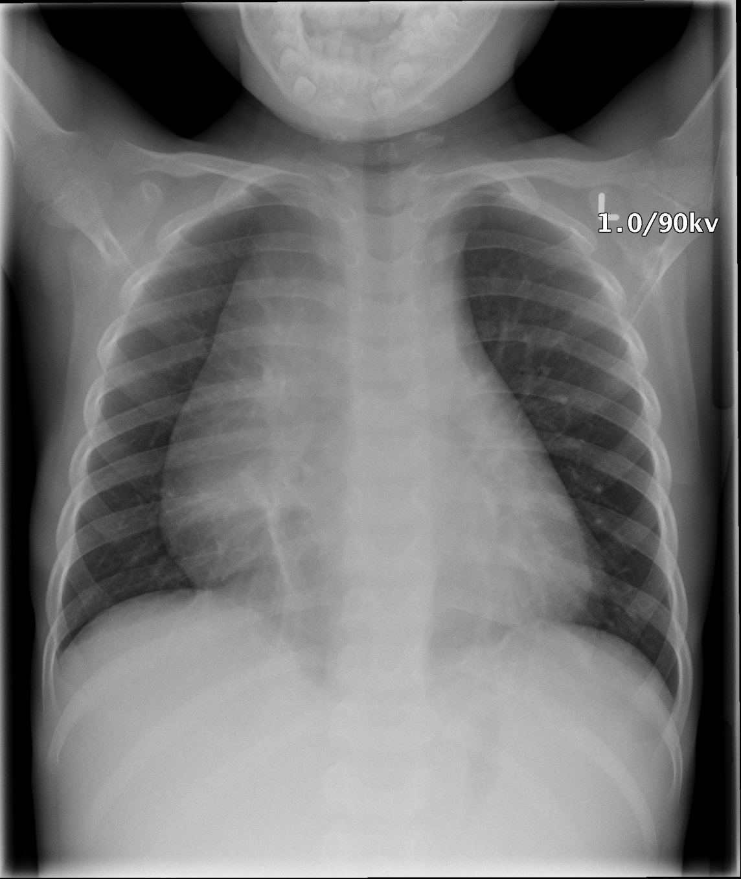

Slide 3
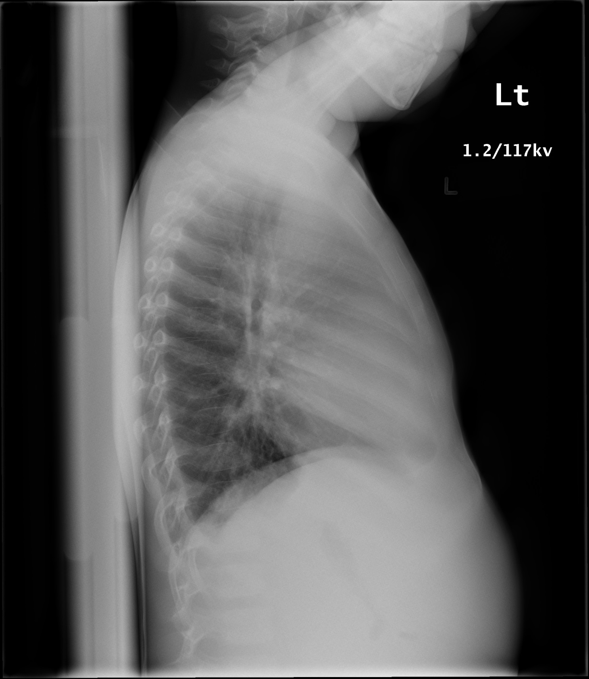

Slide 4
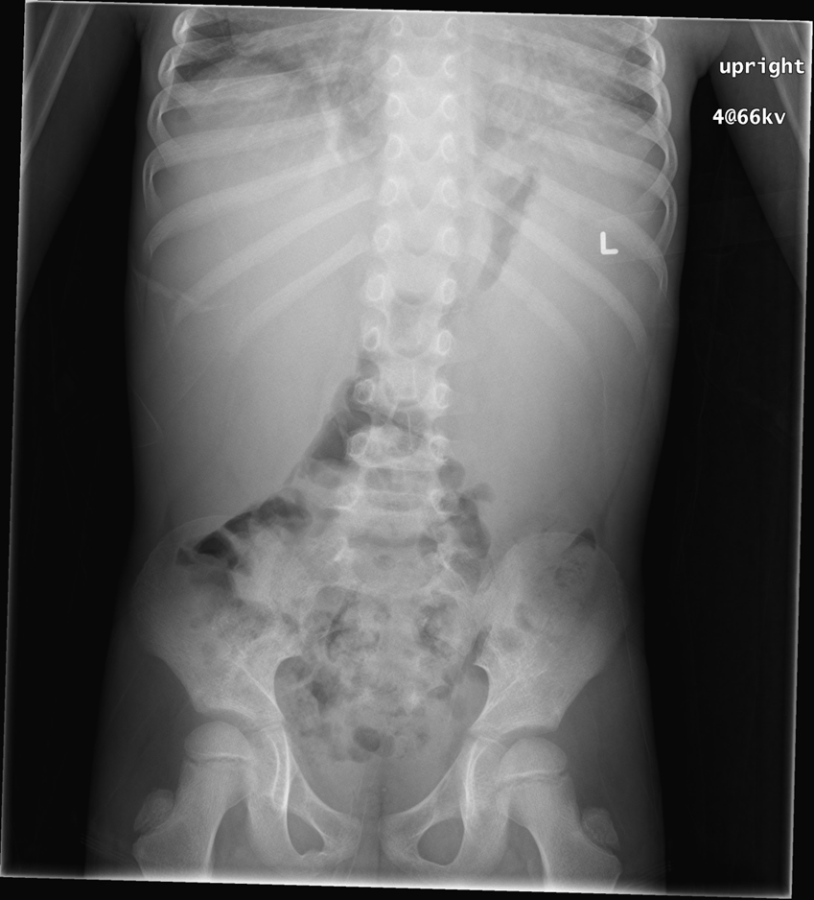

Slide 5
Test | DATE/TIME here | Flag (H or L) | Reference
CBC
WBC | 236 | H | 3.5 – 10.8 10^9/L
Neutrophils | 7.09
Lymphocytes | 4.72
ESR | 59
Reticulocytes | 43
Hgb | 68 | L | 130 – 170 g/L
Platelets | 28 | L | 150 – 400 10^9/L
Chemistry
Na | 138 |  | 137 – 145 mmol/L
K | 4.5 |  | 3.5 – 5.0 mmol/L
Cl | 106 |  | 98 – 107 mmol/L
Ca | 2.18
PO4 | 1.45
Mg | 0.89
Urea | 3.8 |  | 2.5 – 6.1 mmol/L
Creat | 36 |  | 62 – 106 umol/L
CSF
Appearance | Clear and colourless
Nucleated cells | 2 x 10⁶/L
RBC | <1 x 10⁶/L
Lymphocytes | 77%
Macrophages | 23%
 | No blasts seen

