Slide 1




Patient Simulation

Slide 2
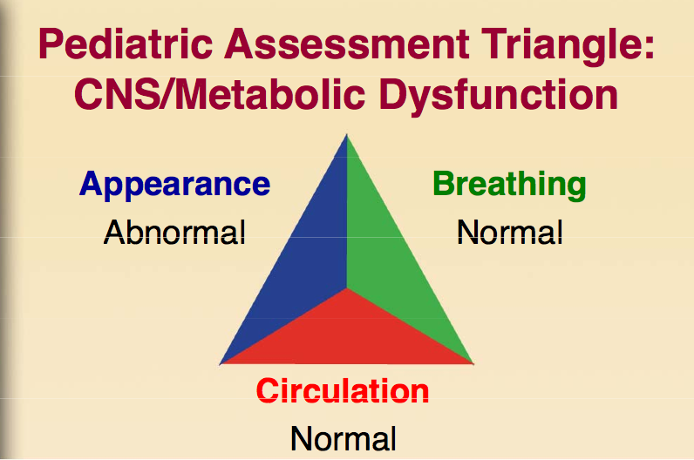

Slide 3
Test | DATE/TIME here | Flag (H or L) | Reference
CBC
WBC | 10.1 |  | 3.5 – 10.8 10^9/L
Hgb | 120 | L | 130 – 170 g/L
MCV | .47 |  | 84.0 – 98.0 fL
Platelets | 400 |  | 150 – 400 10^9/L
Chemistry
Na | 132 | L | 137 – 145 mmol/L
K | 3.3 | L | 3.5 – 5.0 mmol/L
Cl | 100 |  | 98 – 107 mmol/L
HCO3 | 23 | L | 22-26 mmol/L
Urea | 10 | H | 2.5 – 6.1 mmol/L
Creat | 120 | H | 62 – 106 umol/L
GFR Est | 62 |  | > 60 ml/min
Glucose - Random | 4.2 |  | 3.0 – 11.0 mmol/L
Coags
INR | 1.3 | H | 0.9 – 1.2
PTT | 23 |  | 28 – 38 s

