Slide 1




Patient Simulation

Slide 2
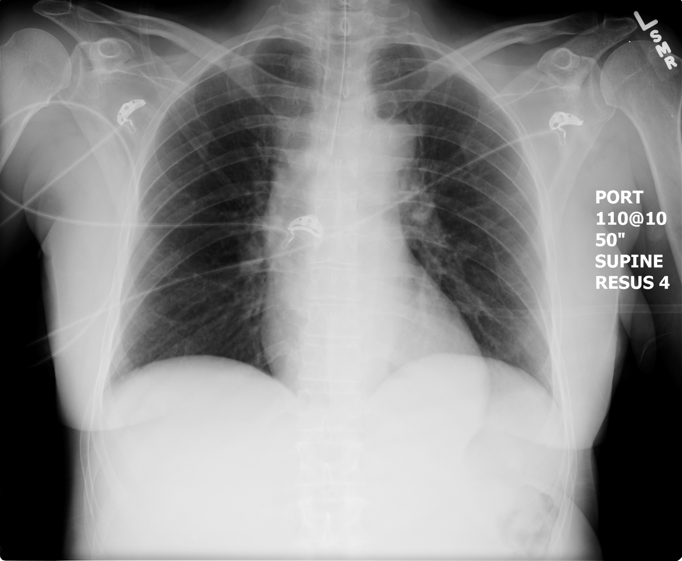

Slide 3
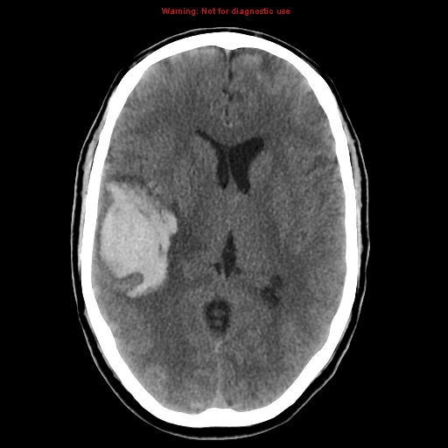

Slide 4
LABORATORY *LIVE* Lab Summary Report
VBGs- 1st cap gas
Venous
pH | 7.31 | L | 7.35- 7.45
pCO2 | 36 | H | 35 – 45 mmHg
PO2 | 80 |  | 80-100 mmHg
BE | -2 |  | -2.0 to +2.0 mmol/L
HCO3 | 22 |  | 22 – 26 mmol/L

Slide 5
LABORATORY *LIVE* Lab Summary Report
VBGs- 2nd cap gas
Venous
pH | 7.23 | L | 7.35- 7.45
pCO2 | 49 | H | 35 – 45 mmHg
PO2 | 90 |  | 80-100 mmHg
BE | -3 | L | -2.0 to +2.0 mmol/L
HCO3 | 21 | L | 22 – 26 mmol/L

