Slide 1




Patient Simulation

Slide 2
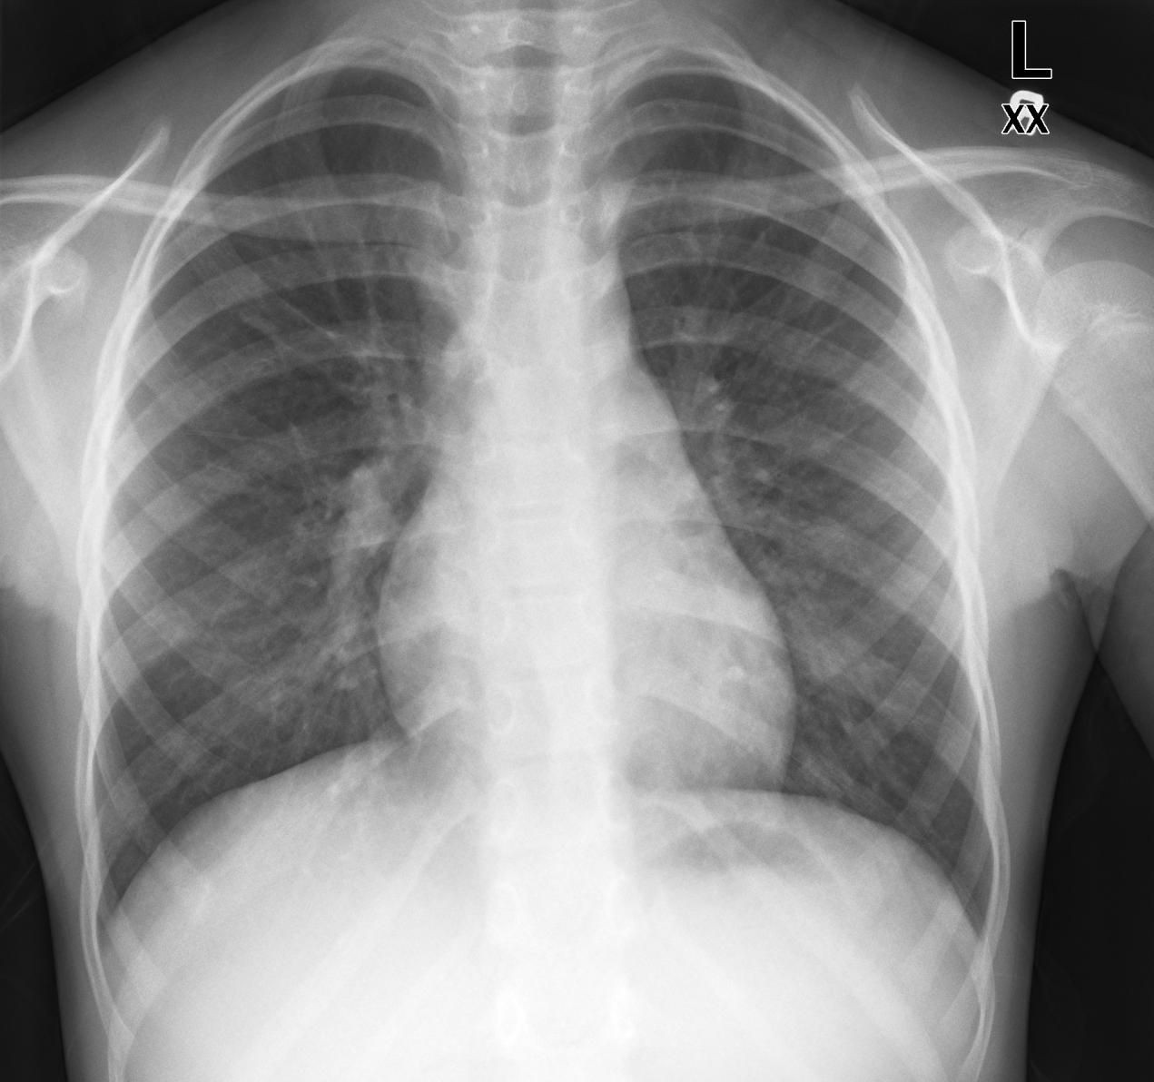

Slide 3
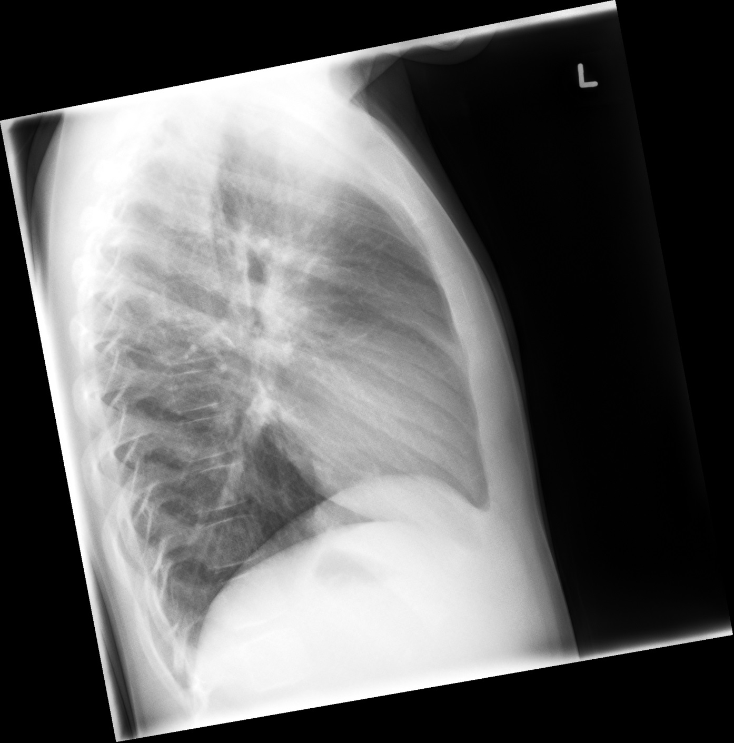

Slide 4
Test | Phase 2 | Flag (H or L) | Reference
CBC
WBC | 27 | H | 3.5 – 10.8 10^9/L
Hgb | 124 | L | 130 – 170 g/L
Platelets | 310 |  | 150 – 400 10^9/L
Chemistry
Na | 130 | L | 137 – 145 mmol/L
K | 3.5 |  | 3.5 – 5.0 mmol/L
Cl | 109 |  | 98 – 107 mmol/L
Urea | 3.4 |  | 2.5 – 6.1 mmol/L
Glucose - Random | 5.0 |  | 3.0 – 11.0 mmol/L
ABGs
Arterial
pH | 7.15 | L | 7.35- 7.45
pCO2 | 60 | H | 35 – 45 mmHg
PO2 | 90 |  | 80-100 mmHg
BE | -8 |  | -2.0 to +2.0 mmol/L
HCO3 | 26 |  | 22 – 26 mmol/L

