Slide 1




Patient Simulation

Slide 2
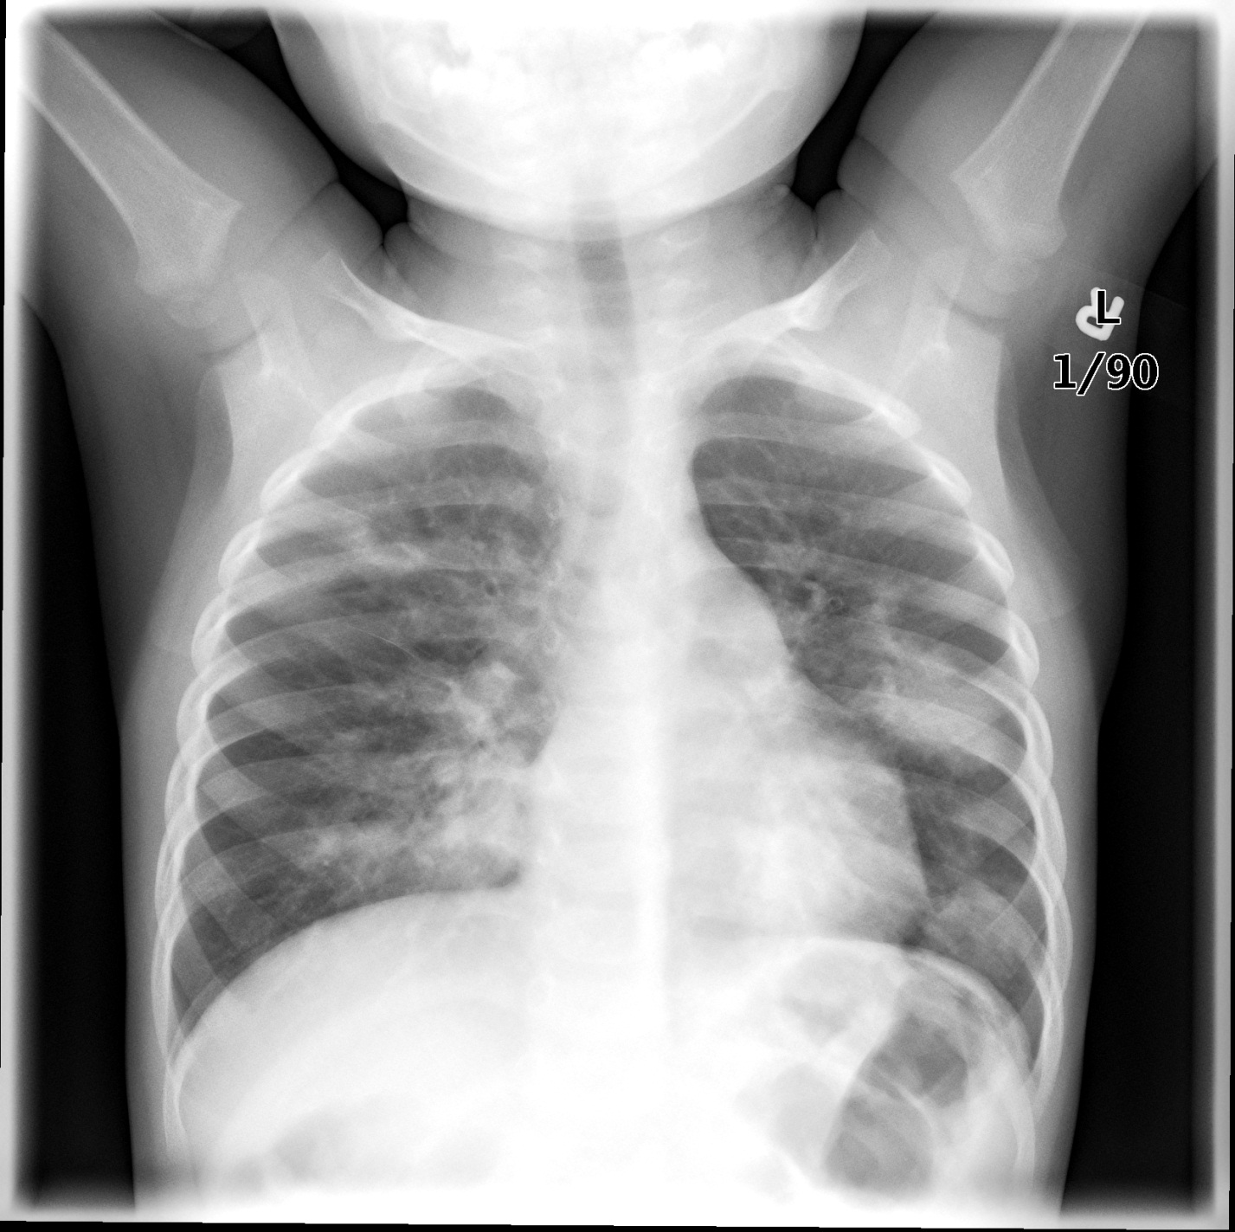

Slide 3
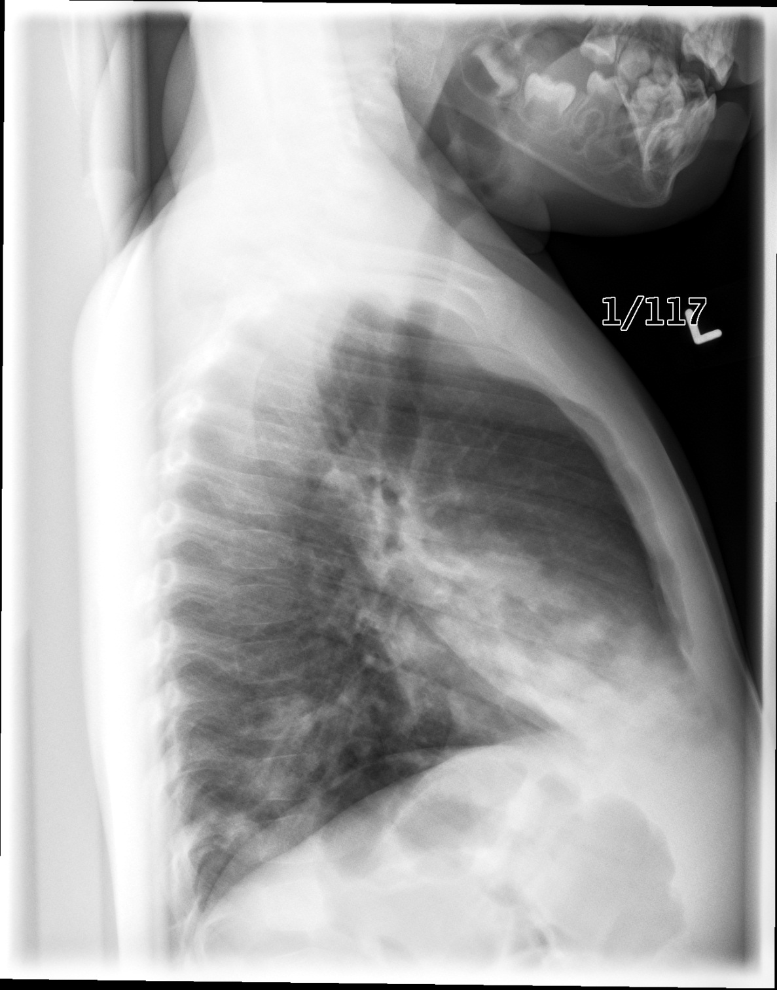

Slide 4
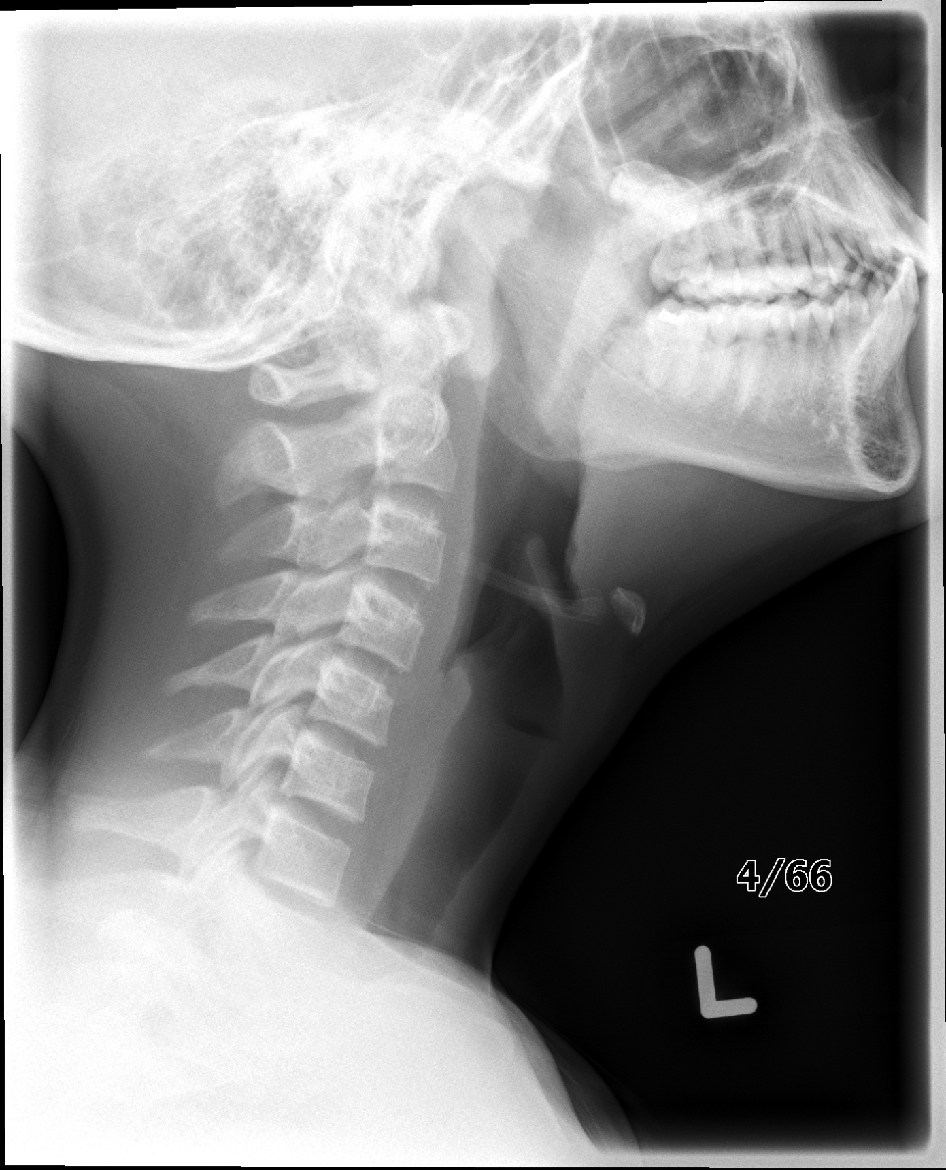

Slide 5
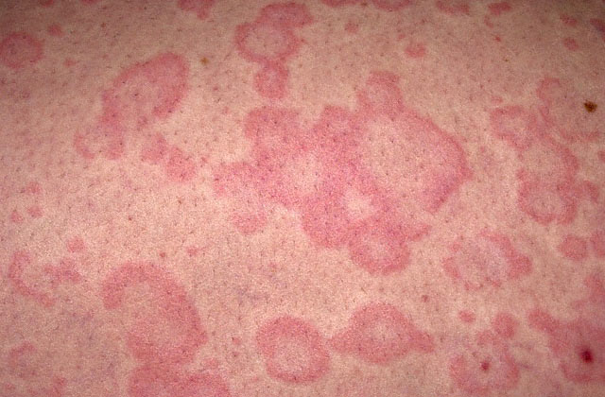

Slide 6
Test | DATE/TIME here | Flag (H or L) | Reference
CBC
WBC | 22 | H | 3.5 – 10.8 10^9/L
Neutrophils | 16.6
Hgb | 120 | L | 130 – 170 g/L
Chemistry
Na | 138 | H | 137 – 145 mmol/L
K | 3.9 |  | 3.5 – 5.0 mmol/L
Cl | 105 |  | 98 – 107 mmol/L
Urea | 2.9 |  | 2.5 – 6.1 mmol/L
Creat | 35 | L | 62 – 106 umol/L
ABGs
Arterial
pH | 7.35 |  | 7.35- 7.45
pCO2 | 42 |  | 35 – 45 mmHg
PO2 | 90 |  | 80-100 mmHg
BE | -4 |  | -2.0 to +2.0 mmol/L
HCO3 | 21 | L | 22 – 26 mmol/L
O2 Sat |  |  | 95 – 100%

