Slide 1




Patient Simulation

Slide 2
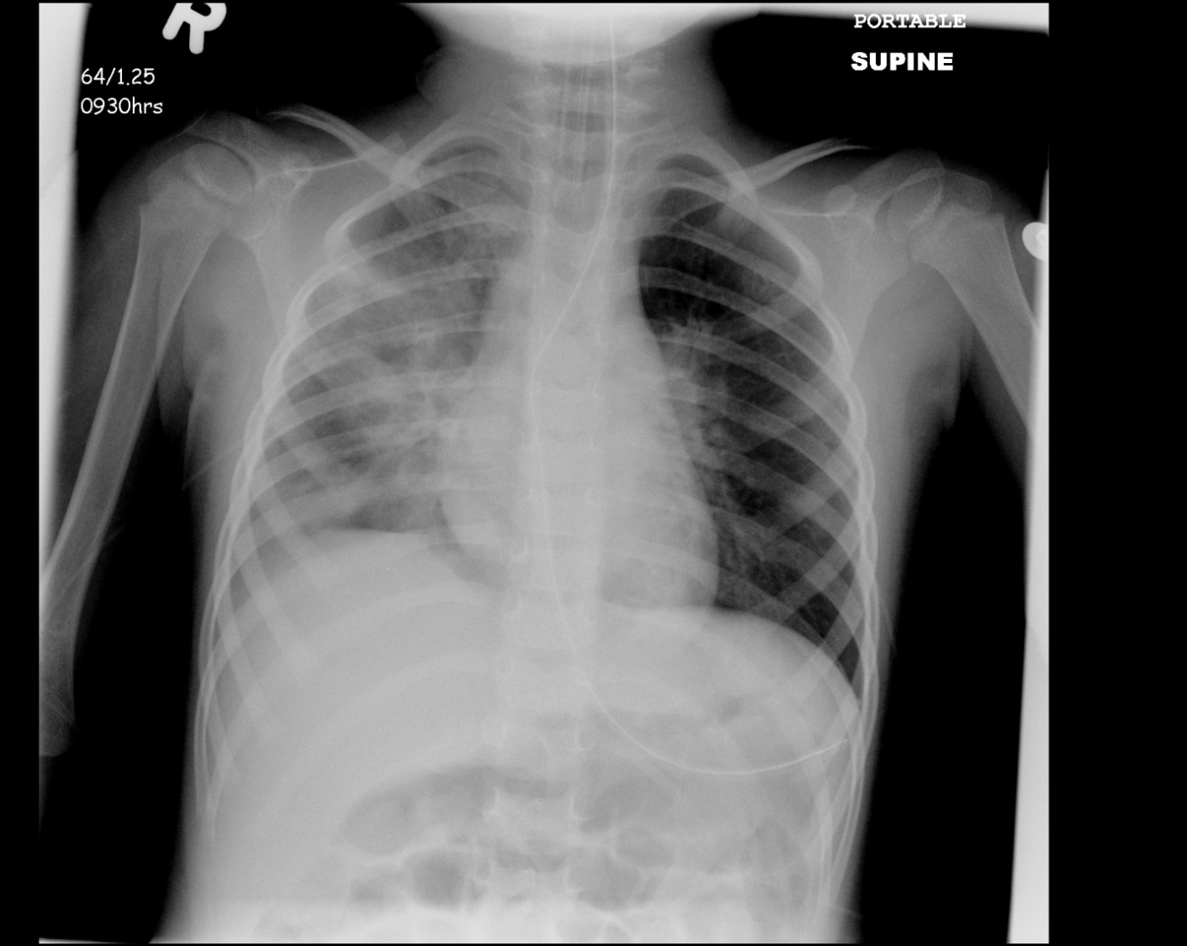

Slide 3
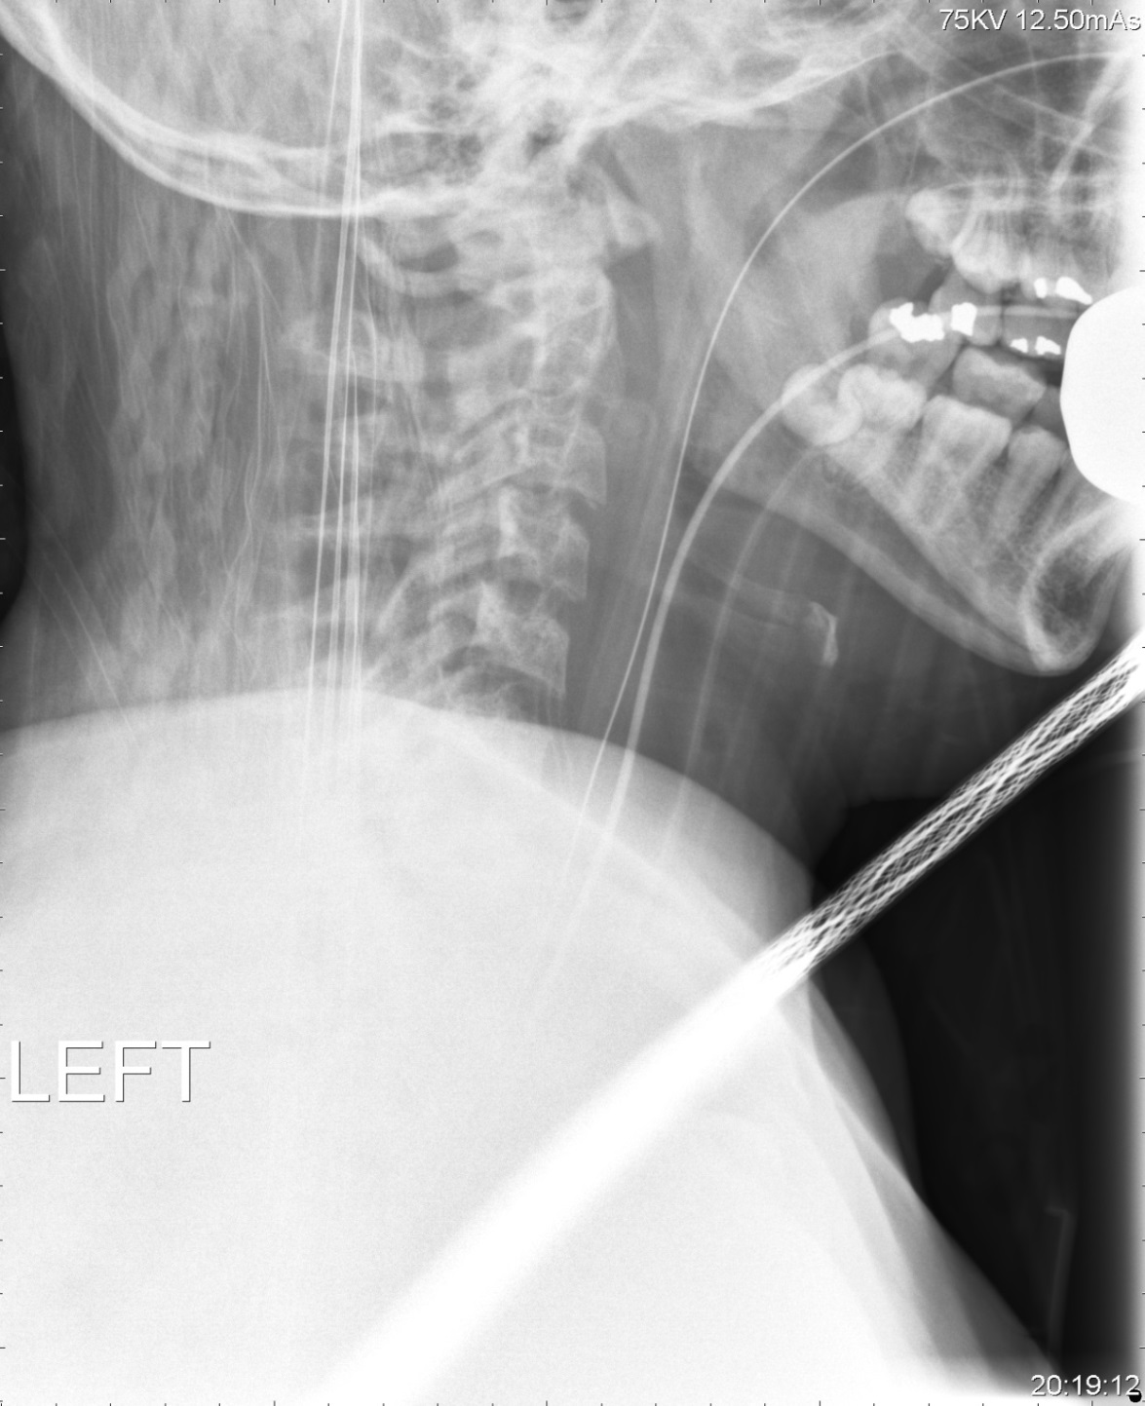

Slide 4
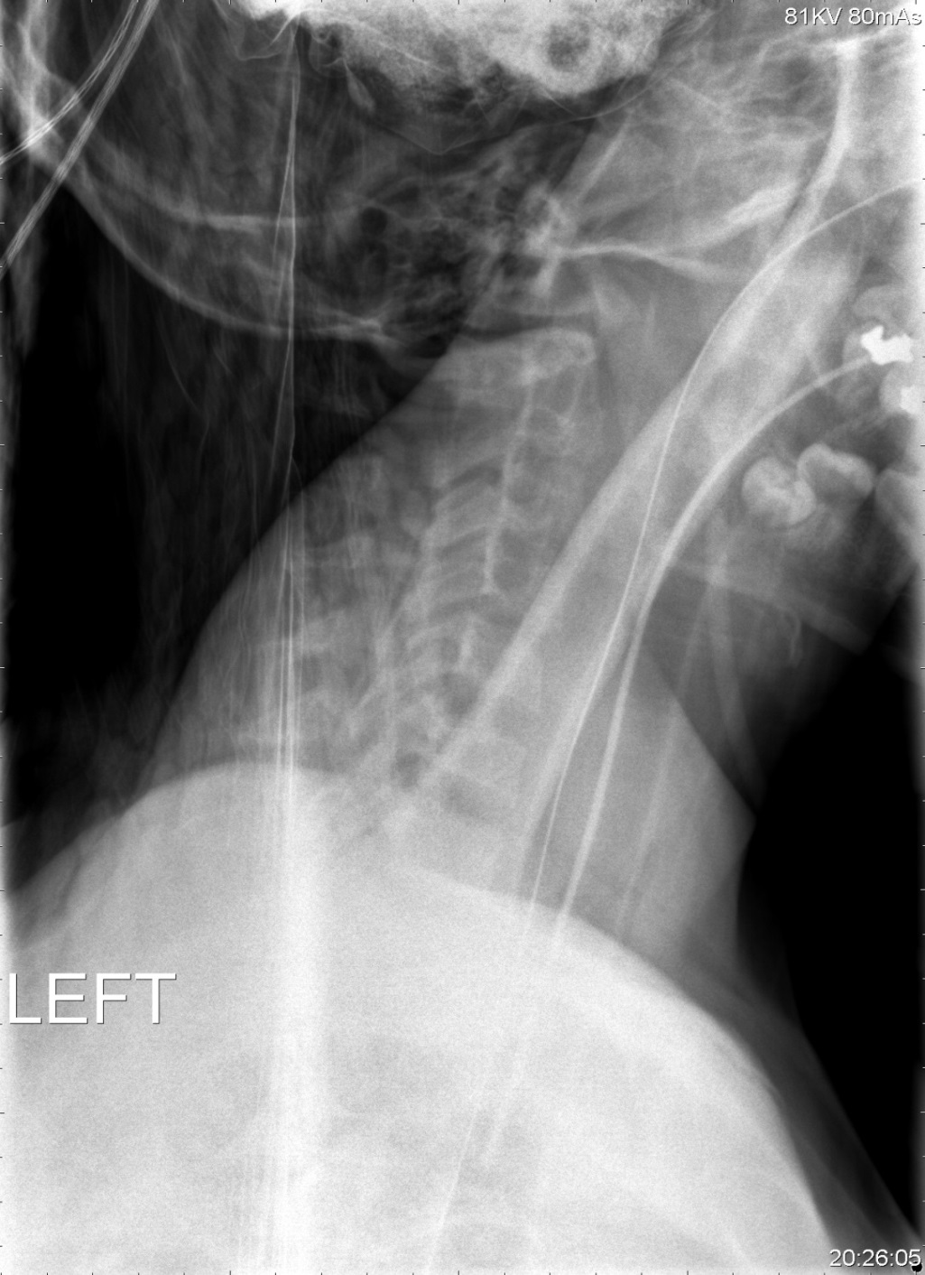

Slide 5
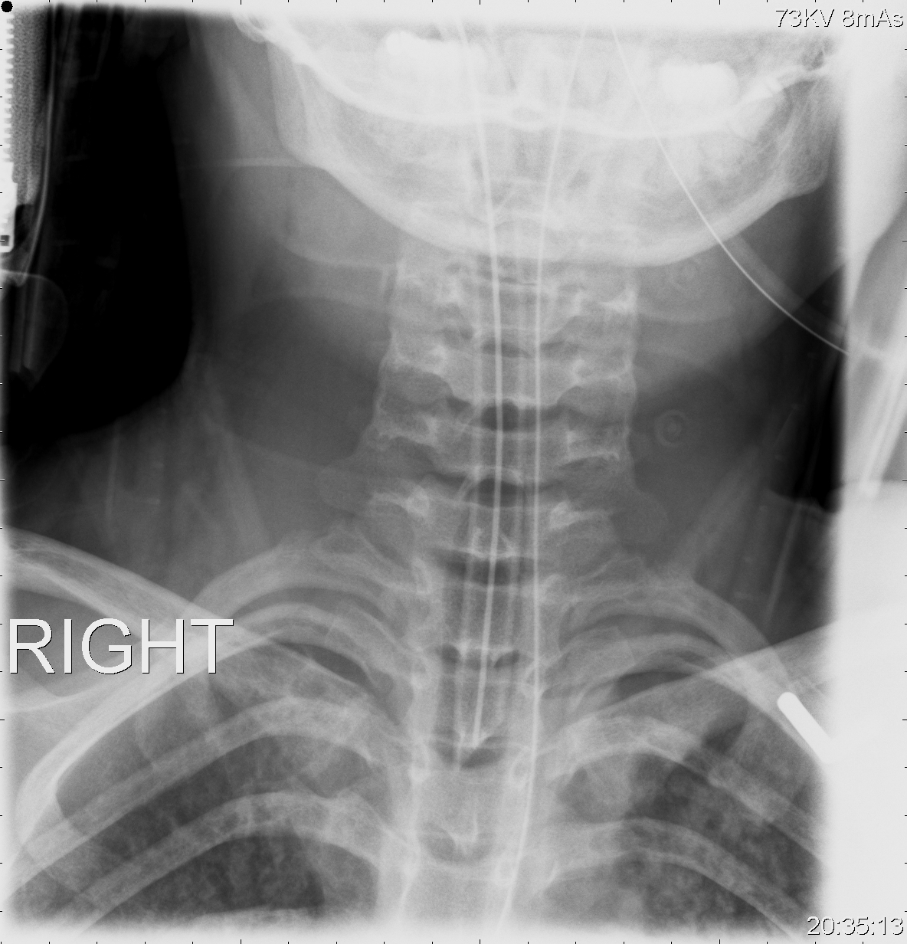

Slide 6
LABORATORY *LIVE* Lab Summary Report
Test | DATE/TIME here | Flag (H or L) | Reference
Chemistry
Glucose - Random | 1.4 | L | 3.0 – 11.0 mmol/L
Lactate | 8.0 | H | 0.9 – 1.8 mmol/L
ABGs
Arterial
pH | 6.90 | L | 7.35- 7.45
pCO2 | 11 | L | 35 – 45 mmHg
PO2 | 60 | L | 80-100 mmHg
BE | -22 | L | -2.0 to +2.0 mmol/L
HCO3 | 3 | L | 22 – 26 mmol/L

