Slide 1




Patient Simulation

Slide 2
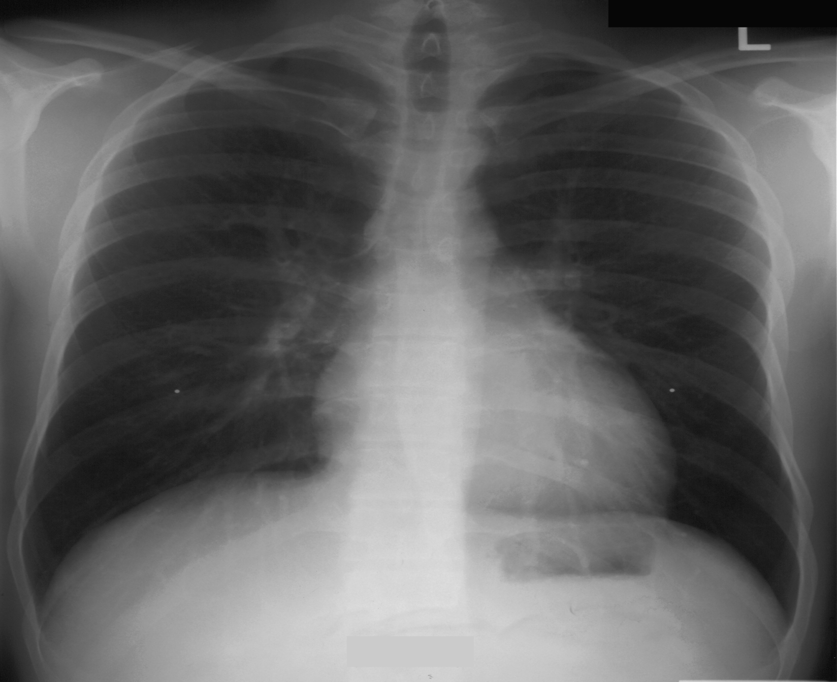
Pre- intubation CXR

Slide 3
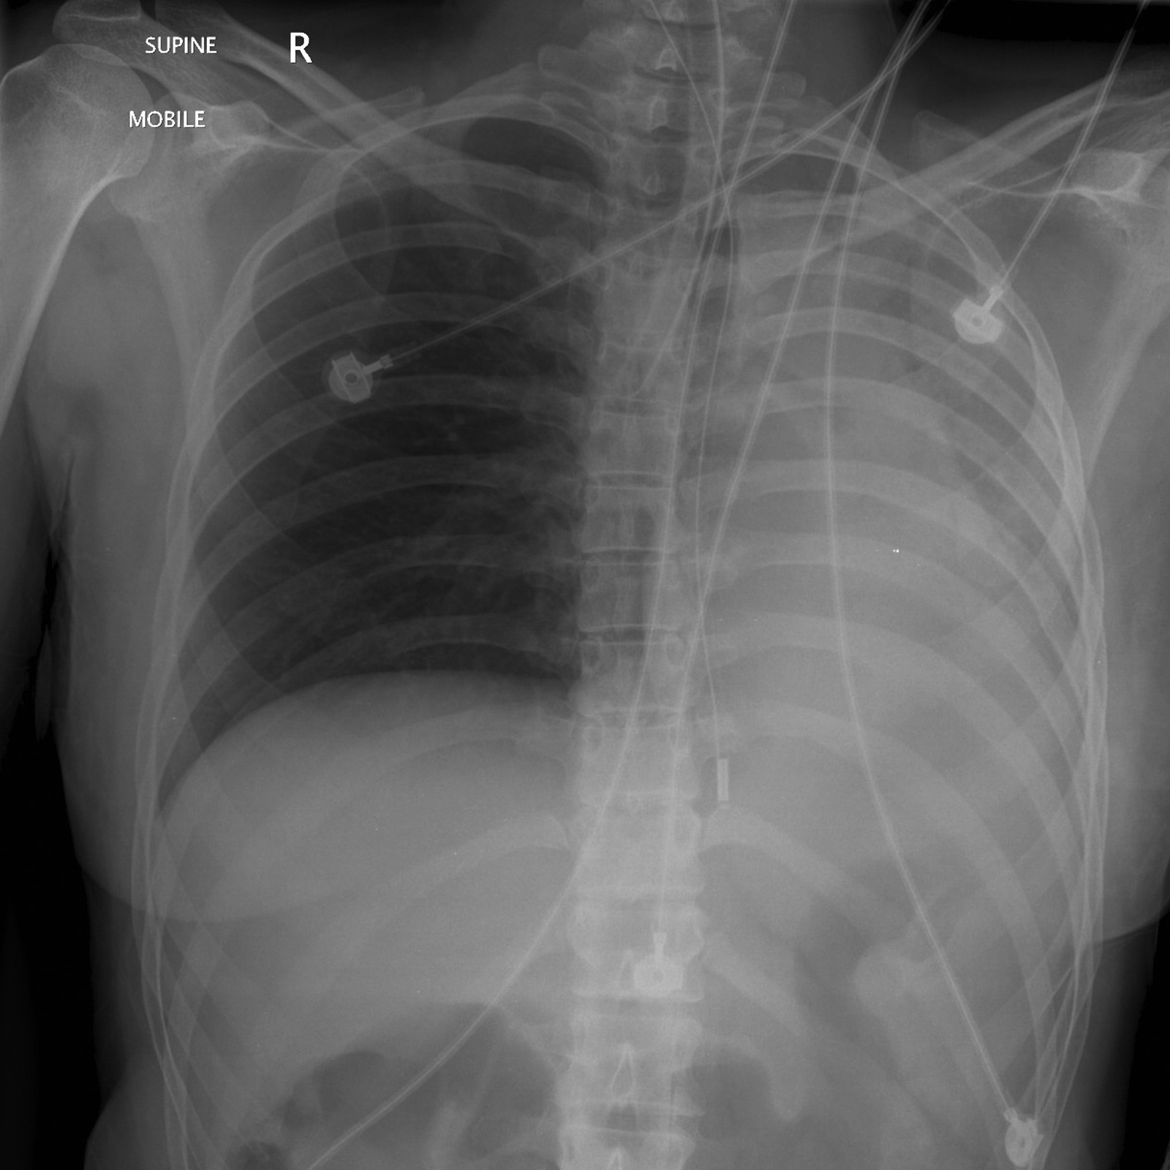
Post- intubation CXR

Slide 4
Test | INITIAL LABS | Flag (H or L) | Reference
CBC
WBC | 22 | H | 3.5 – 10.8 10^9/L
Hgb | 100 | L | 130 – 170 g/L
Platelets | 550 | H | 150 – 400 10^9/L
Chemistry
Na | 130 | L | 137 – 145 mmol/L
K | 6.7 | H | 3.5 – 5.0 mmol/L
Cl | 110 | H | 98 – 107 mmol/L
Urea | 7.6 | H | 2.5 – 6.1 mmol/L
Creat | 110 | H | 62 – 106 umol/L
Glucose - Random | 4.0 |  | 3.0 – 11.0 mmol/L
CK | 1200 | H | 5 – 130 U/L

Slide 5
Test | REPEAT LABS | Flag (H or L) | Reference
CBC- Pending
WBC |  |  | 3.5 – 10.8 10^9/L
Hgb |  |  | 130 – 170 g/L
Platelets |  |  | 150 – 400 10^9/L
Chemistry
Na | 131 | L | 137 – 145 mmol/L
K | 8.2. | H | 3.5 – 5.0 mmol/L
Cl | 102 |  | 98 – 107 mmol/L
Urea | 9.0 | H | 2.5 – 6.1 mmol/L
Creat | 150 | H | 62 – 106 umol/L
Glucose - Random | 4.5 |  | 3.0 – 11.0 mmol/L
ABGs
Arterial
pH | 7.10 | L | 7.35- 7.45
pCO2 | 15 | L | 35 – 45 mmHg
PO2 | 90 |  | 80-100 mmHg
BE | -17 | L | -2.0 to +2.0 mmol/L
HCO3 | 8 | L | 22 – 26 mmol/L

