Slide 1




Patient Simulation

Slide 2
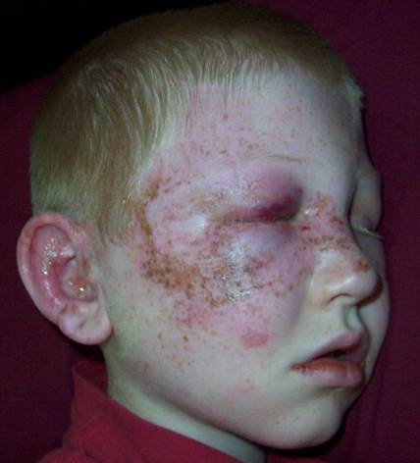

Slide 3
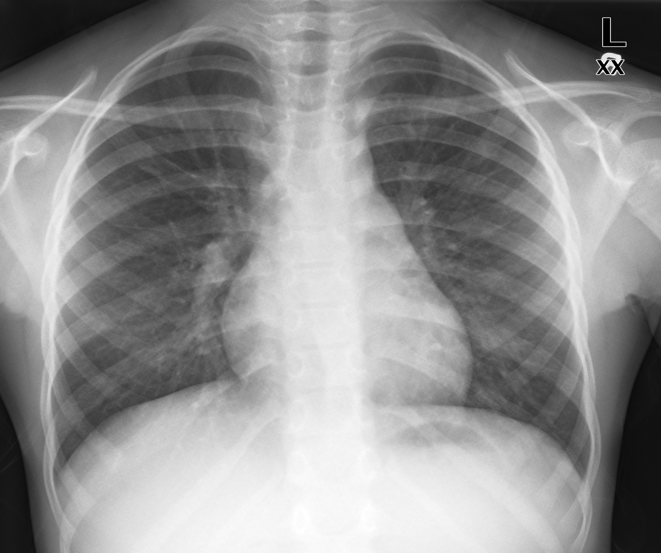

Slide 4
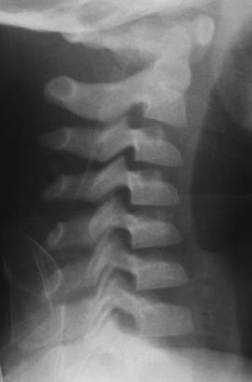

Slide 5
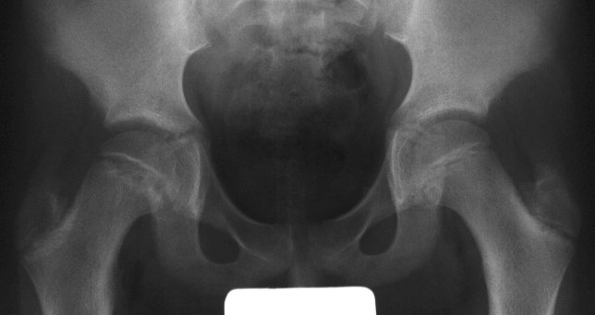

Slide 7
LABS – click here OR fill out below
LABORATORY *LIVE* Lab Summary Report
Test | DATE/TIME here | Flag (H or L) | Reference
CBC
WBC | 15.5 | H | 3.5 – 10.8 10^9/L
Hgb | 70 | L | 130 – 170 g/L
Platelets | 500 | H | 150 – 400 10^9/L
Chemistry
Na | 135 | L | 137 – 145 mmol/L
K | 4.5 |  | 3.5 – 5.0 mmol/L
Cl | 103 |  | 98 – 107 mmol/L
Urea | 4.2 |  | 2.5 – 6.1 mmol/L
Creat | 46 | L | 62 – 106 umol/L
Glucose - Random | 4.6 |  | 3.0 – 11.0 mmol/L
Coags
INR | 1.2 |  | 0.9 – 1.2
PTT | 42 | H | 28 – 38 s
ABGs
Arterial
pH | 7.20 | L | 7.35- 7.45
pCO2 | 40 | H | 35 – 45 mmHg
PO2 | 80 |  | 80-100 mmHg
BE | -15 | L | -2.0 to +2.0 mmol/L
HCO3 | 10 | L | 22 – 26 mmol/L

