Slide 1




Patient Simulation

Slide 2
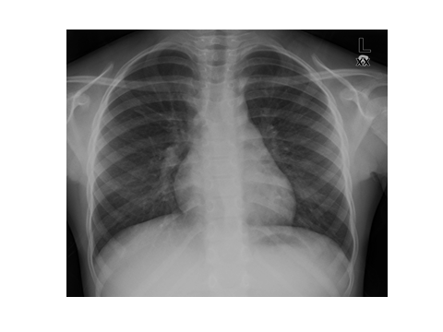

Slide 3
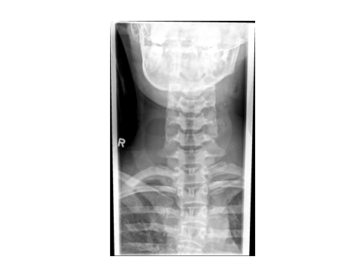

Slide 4
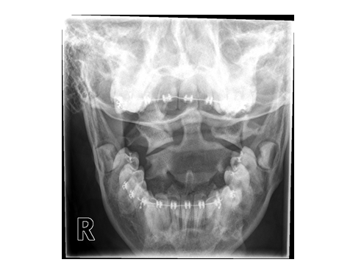

Slide 5
Test | DATE/TIME here | Flag (H or L) | Reference
CBC
WBC | 18 | H | 3.5 – 10.8 10^9/L
Hgb | 110 | L | 130 – 170 g/L
Platelets | 450 | H | 150 – 400 10^9/L
Chemistry
Na | 131 | L | 137 – 145 mmol/L
K | 5.5 | H | 3.5 – 5.0 mmol/L
Cl | 103 |  | 98 – 107 mmol/L
Urea | 5.7 |  | 2.5 – 6.1 mmol/L
Creat | 80 |  | 62 – 106 umol/L
Glucose - Random | 3.5 |  | 3.0 – 11.0 mmol/L
Lactate | 11 | H | 0.9 – 1.8 mmol/L
Other
CO | 0.38
ABGs
Arterial
pH | 7.05 | L | 7.35- 7.45
pCO2 | 25 | L | 35 – 45 mmHg
PO2 | 90 |  | 80-100 mmHg
BE | -18 |  | -2.0 to +2.0 mmol/L
HCO3 | 7 | L | 22 – 26 mmol/L
O2 Sat |  |  | 95 – 100%

Slide 6
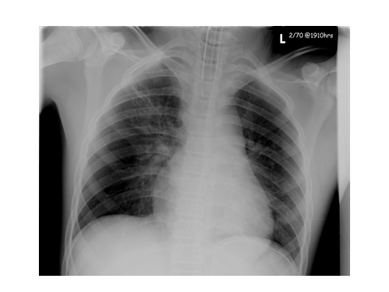

Slide 7
Test | DATE/TIME here | Flag (H or L) | Reference
Chemistry
Na | 131 | L | 137 – 145 mmol/L
K | 8.2 | H | 3.5 – 5.0 mmol/L
Cl | 102 |  | 98 – 107 mmol/L
Glucose - Random | 4.5 |  | 3.0 – 11.0 mmol/L
ABGs
Arterial
pH | 7.10 | L | 7.35- 7.45
pCO2 | 15 | L | 35 – 45 mmHg
PO2 | 90 |  | 80-100 mmHg
BE | -17 |  | -2.0 to +2.0 mmol/L
HCO3 | 8 | L | 22 – 26 mmol/L
O2 Sat |  |  | 95 – 100%

Slide 8
