Slide 1




Patient Simulation

Slide 2
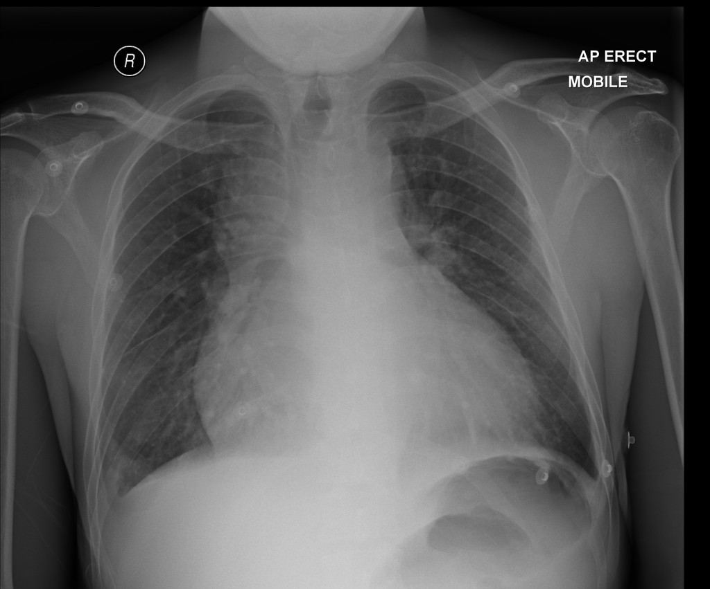

Slide 3
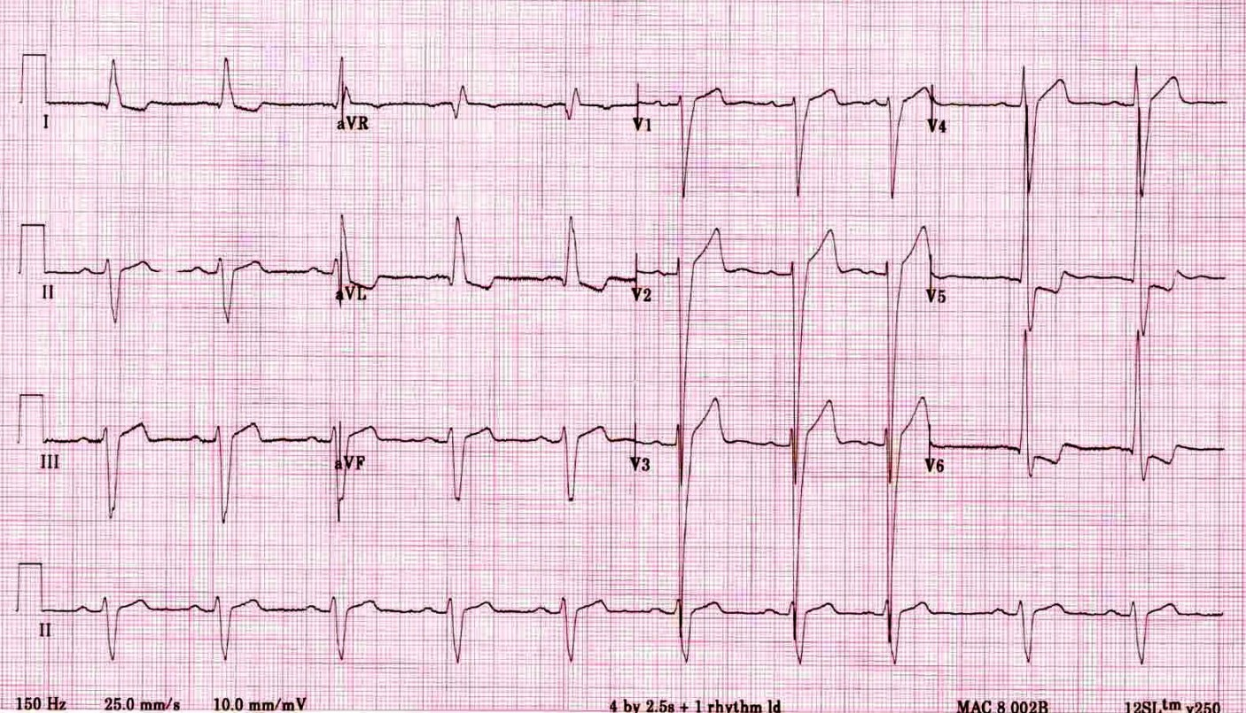

Slide 4
LABORATORY *LIVE* Lab Summary Report
Test | DATE/TIME here |  | Flag (H or L) | Reference
CBC
WBC | 12.9 |  | H | 3.5 – 10.8 10^9/L
RBC | 5.0 |  |  | 4.3 – 5.7 10^12/L
Hgb | 141 |  |  | 130 – 170 g/L
HCT | 0.40 |  |  | 0.37 – 0.47 L/L
Platelets | 330 |  |  | 150 – 400 10^9/L
D- Dimer | 7000 |  | H | <250 mcg/L
Chemistry
Na |  | 140 |  | 137 – 145 mmol/L
K |  | 3.8 |  | 3.5 – 5.0 mmol/L
Cl |  | 102 |  | 98 – 107 mmol/L
HCO3 |  | 16 | L | 22-26 mmol/L
Urea |  | 18.1 | H | 2.5 – 6.1 mmol/L
Creat |  | 300 | H | 62 – 106 umol/L
GFR Est |  | 23 | L | > 60 ml/min
Glucose - Random |  | 18 | H | 3.0 – 11.0 mmol/L
Lactate |  | 3.0 | H | 0.9 – 1.8 mmol/L
CK |  | 150 | H | 5 – 130 U/L
Troponin |  | 0.03 | H | <0.03 mcg/L

Slide 5
Test | DATE/TIME here | Flag (H or L) | Reference
Coags
INR | 1.0 |  | 0.9 – 1.2
PTT | 30 |  | 28 – 38 s
ABGs
Arterial
pH | 7.36 |  | 7.35- 7.45
pCO2 | 36 |  | 35 – 45 mmHg
PO2 | 93 |  | 80-100 mmHg
BE | 1.0 |  | -2.0 to +2.0 mmol/L
HCO3 | 22 |  | 22 – 26 mmol/L
O2 Sat | 93 |  | 95 – 100%

