Slide 1




Patient Simulation

Slide 2
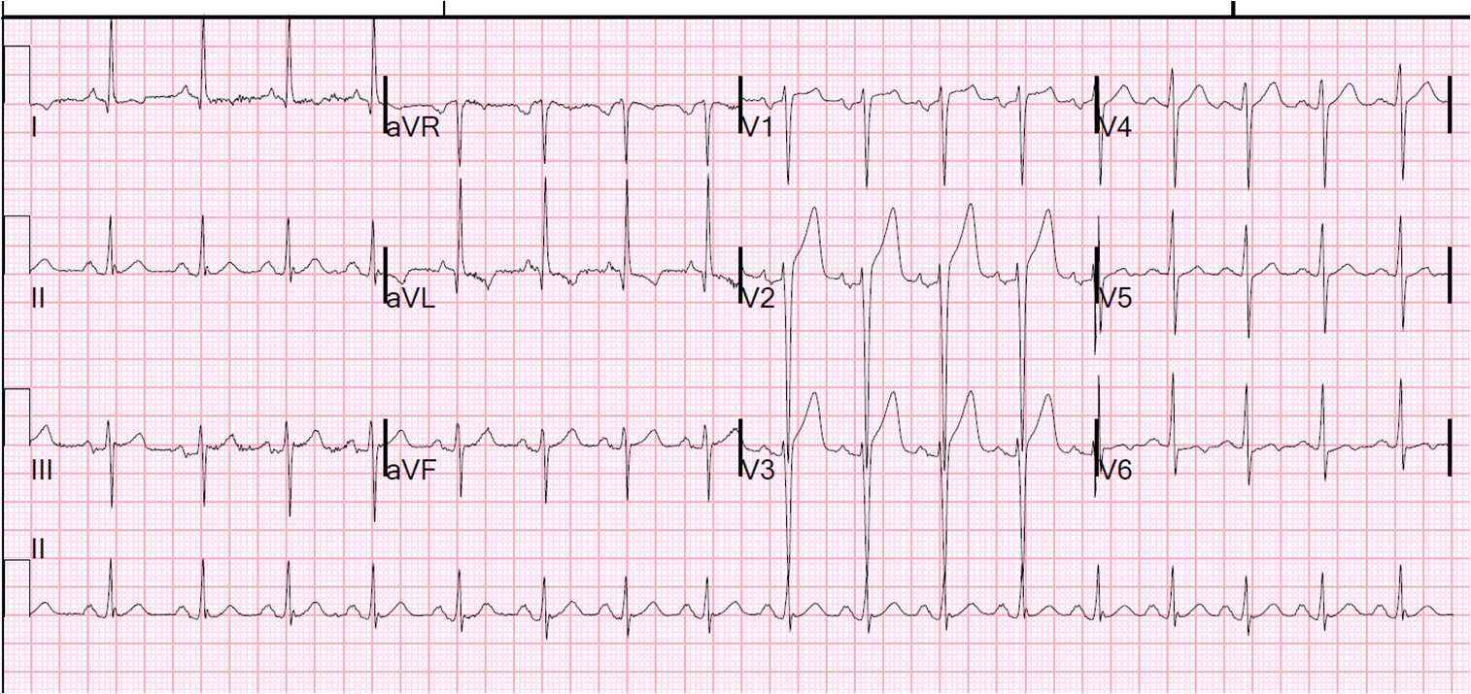

Slide 3
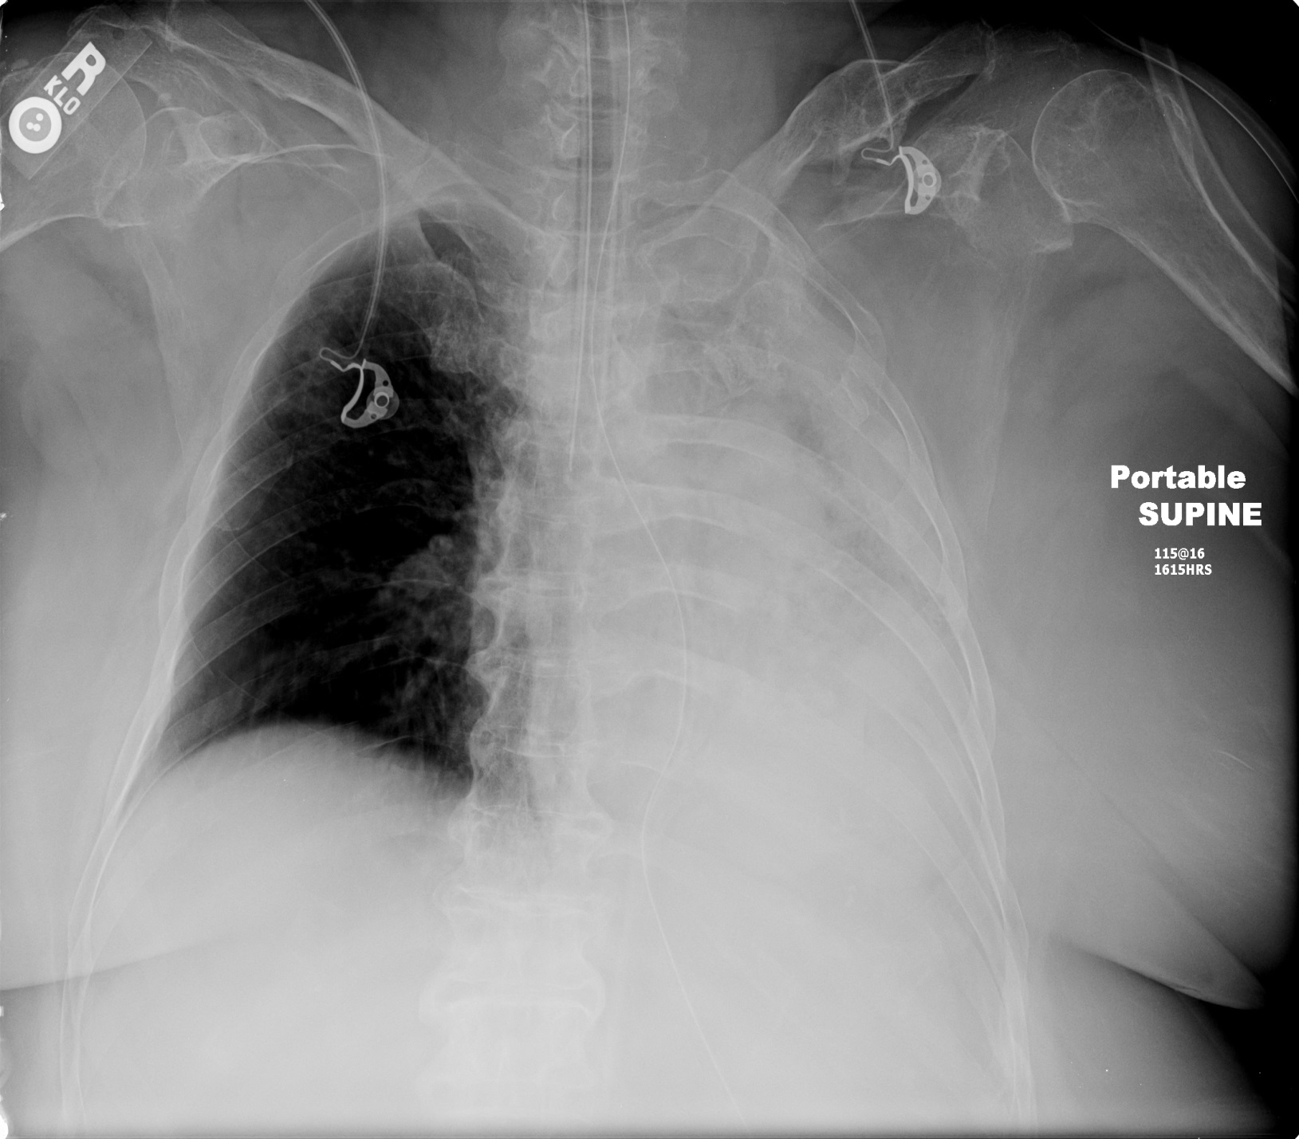

Slide 4
End of Show

