Slide 1




Patient Simulation

Slide 3
Test | DATE/TIME | Flag (H or L) | Reference
CBC
WBC | 31.0 | H | 3.5 – 10.8 10^9/L
Neutrophils | 26.97 | H | 1.50-7.40 10^9/L
Lymphocytes | 2.17 |  | 1.00-3.60 10^9/L
Monocytes | 1.24 | H | 0.10-0.70 10^9/L
RBC | 5.1 | H | 4.3 – 5.7 10^12/L
Hgb | 172 | H | 130 – 170 g/L
HCT | 0.51 | H | 0.37 – 0.47 L/L
MCV | 100.4 | H | 84.0 – 98.0 fL
MCH | 34.1 |  | 28.3 – 33.5 pg
MCHC | 339 |  | 329 – 352 g/L
RDW | 13% |  | 12.0/15.0 %
Platelets | 242 |  | 150 – 400 10^9/L

Slide 4
Test | DATE/TIME | Flag (H or L) | Reference
Chemistry
Na |  | 126 | L | 137 – 145 mmol/L
K |  | 6.0 | H | 3.5 – 5.0 mmol/L
Cl |  | 88 | L | 98 – 107 mmol/L
HCO3 |  | <5 | L | 22-26 mmol/L
Urea |  | 6 |  | 2.5 – 6.1 mmol/L
Creat |  | 131 | H | 62 – 106 umol/L
Alkaline Phosphatase |  | 276 | H | 62-209 U/L
AST |  | 31 | H | 10-30 U/L
Lacatate Dehydrogenase |  | 683 |  | 340-750 U/L
GGT |  | 29 | H | 10-23 U/L
ALT |  | 28 |  | 6-30 U/L
Lipase |  | 40 |  | 10-220 U/L
Glucose - Random |  | 53.1 | H | 3.0 – 11.0 mmol/L
Lactate |  | 6.0 | H | 0.9 – 1.8 mmol/L

Slide 5
Test | DATE/TIME | Flag (H or L) | Reference
ABGs
Arterial
pH | 7.03 | L | 7.35- 7.45
pCO2 | 9 | L | 35 – 45 mmHg
PO2 | 164 | H | 80-100 mmHg
BE | -26.1 |  | -2.0 to +2.0 mmol/L
HCO3 | 2 | L | 22 – 26 mmol/L
O2 Sat |  |  | 95 – 100%

Slide 6
The following slides for debrief discussion

Slide 7
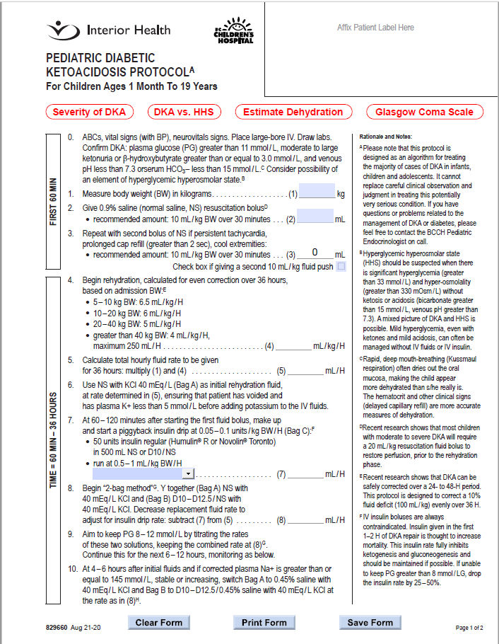

Slide 8
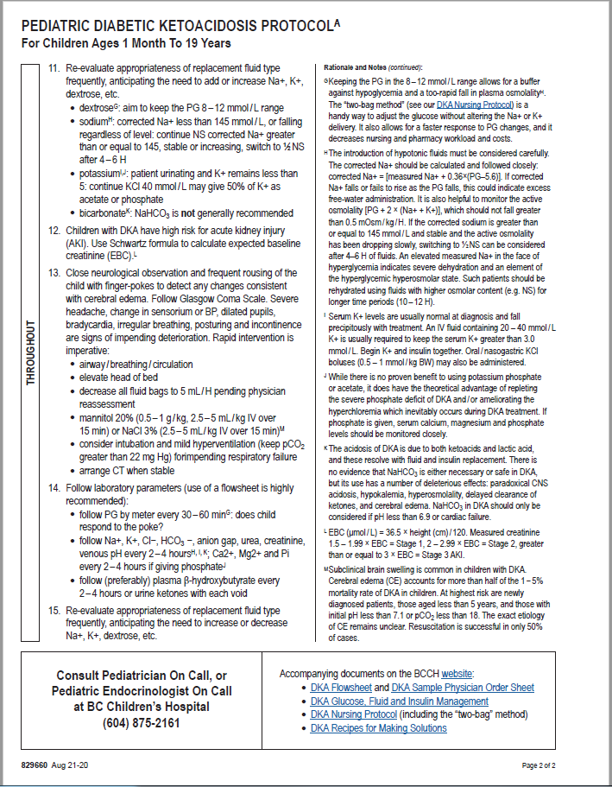

Slide 9
