Slide 1




Patient Simulation

Slide 2
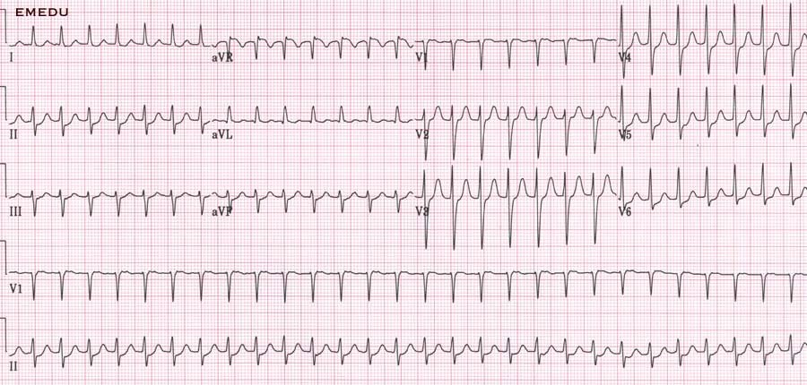

Slide 3
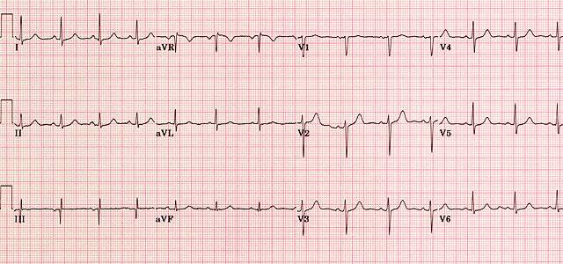

Slide 4
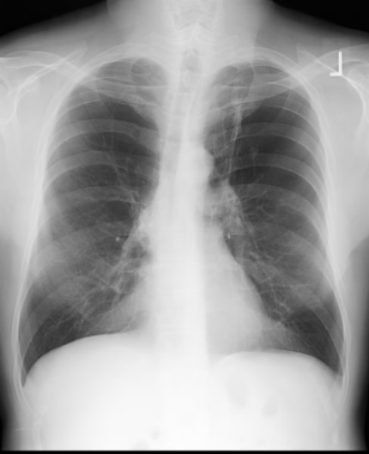

Slide 5
LABORATORY *LIVE* Lab Summary Report
Test | DATE/TIME here | Flag (H or L) | Reference
CBC
WBC | 9.2 |  | 3.5 – 10.8 10^9/L
Hgb | 130 |  | 130 – 170 g/L
HCT | 37 |  | 0.37 – 0.47 L/L
Platelets | 227 |  | 150 – 400 10^9/L
Chemistry
Na | 138 |  | 137 – 145 mmol/L
K | 3.9 |  | 3.5 – 5.0 mmol/L
Cl | 100 |  | 98 – 107 mmol/L
HCO3 | 24 |  | 22-26 mmol/L
Urea | 5.3 |  | 2.5 – 6.1 mmol/L
Creat | 78 |  | 62 – 106 umol/L
Glucose - Random | 6.4 |  | 3.0 – 11.0 mmol/L
Troponin | <0.03 |  | <0.03 mcg/L

