Slide 1




Patient Simulation

Slide 2
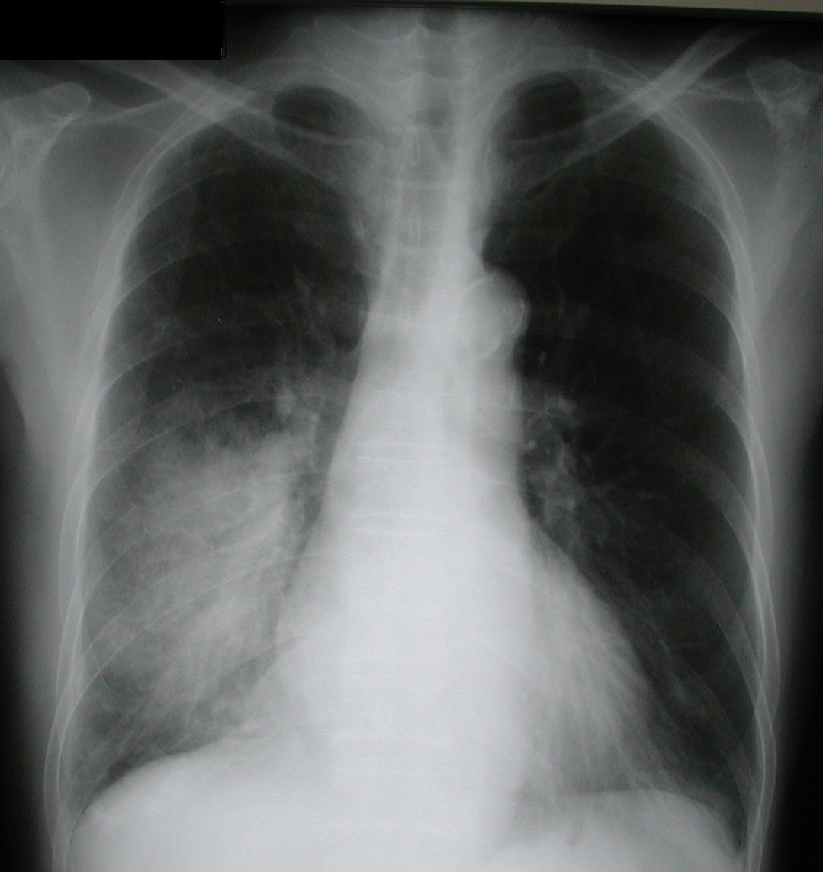

Slide 5
