Slide 1



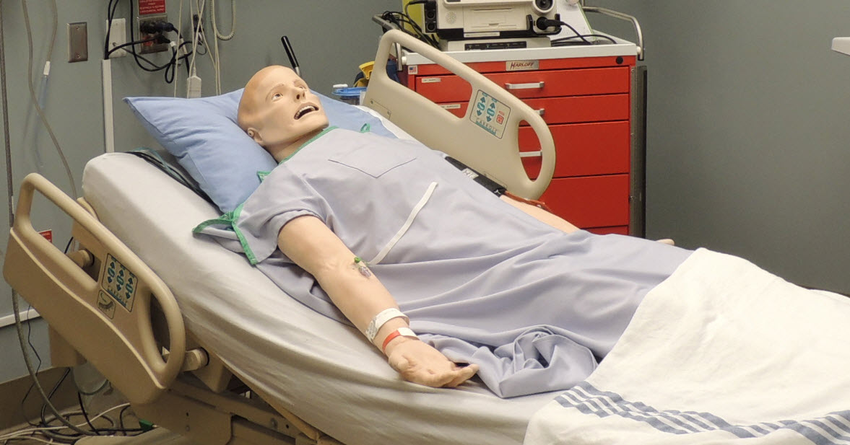
Patient Simulation

Slide 2
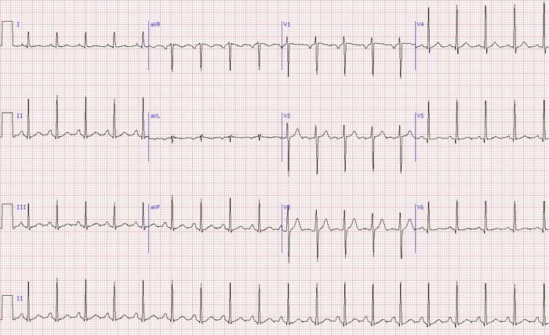

Slide 3
LABORATORY *LIVE* Lab Summary Report
Test | DATE/TIME here | Flag (H or L) | Reference
VBG
pH | 7.35 |  | 7.35- 7.45
pCO2 | 38 |  | 35 – 45 mmHg
HCO3 | 20 | L | 22 – 26 mmol/L

Slide 4
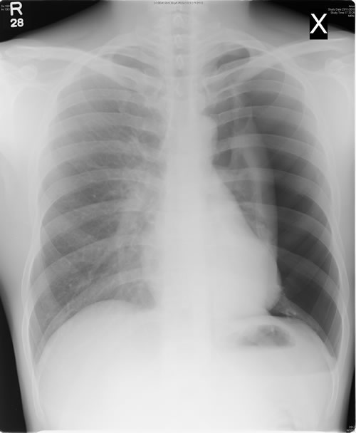

Slide 5
END SHOW

