Slide 1




Patient Simulation

Slide 2
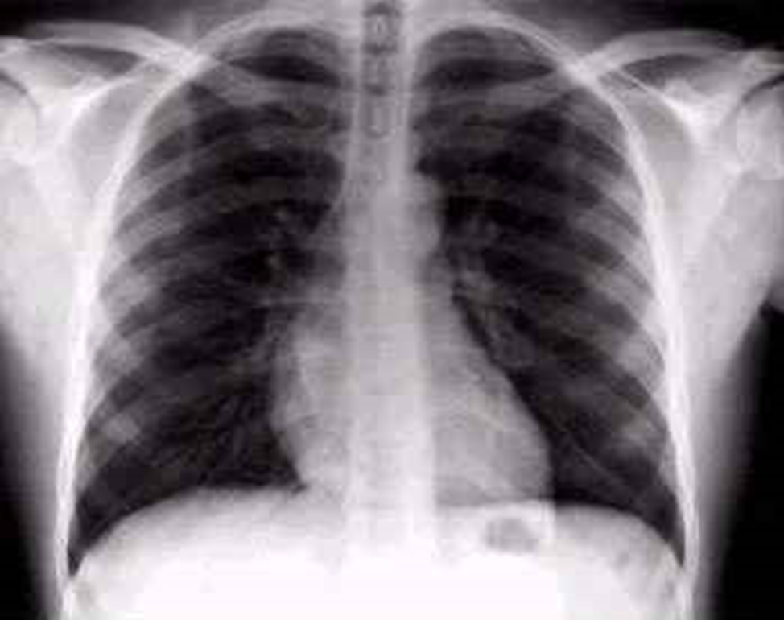

Slide 3
Test | DATE/TIME here | Flag (H or L) | Reference
CBC
WBC | 15.2 | H | 3.5 – 10.8 10^9/L
Hgb | 142 |  | 130 – 170 g/L
Platelets | 240 |  | 150 – 400 10^9/L
D-Dimer |  |  | <250 mcg/L
Chemistry
Na | 134 | L | 137 – 145 mmol/L
K | 3.2 | L | 3.5 – 5.0 mmol/L
Cl | 98 |  | 98 – 107 mmol/L
HCO3 | 28 | H | 22-26 mmol/L
ABGs
Arterial
pH | 7.21 | L | 7.35- 7.45
pCO2 | 70 | H | 35 – 45 mmHg
PO2 | 65 | L | 80-100 mmHg
HCO3 | 27 | H | 22 – 26 mmol/L

Slide 4
