Slide 1




Patient Simulation

Slide 2
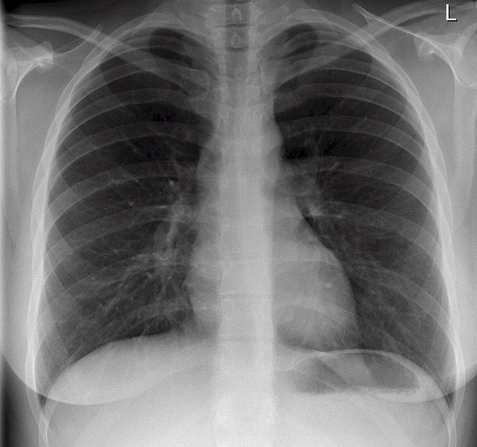

Slide 3
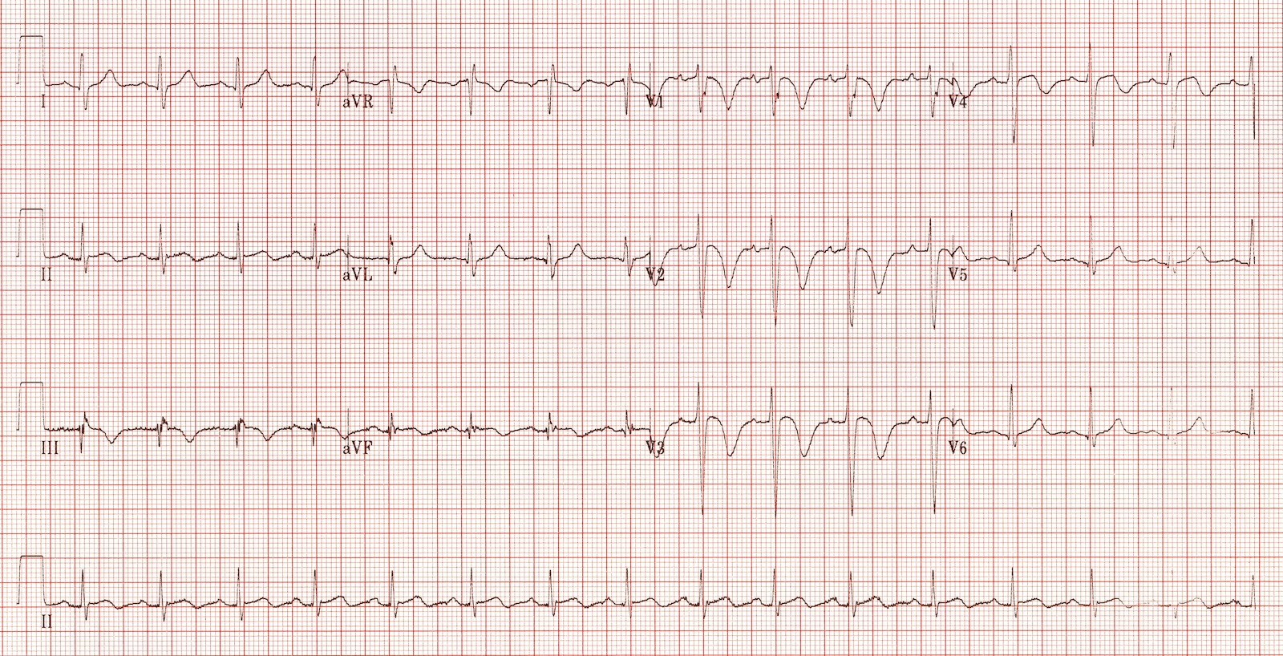
Notes:
Acute right ventricular dilatation due to massive PE

Slide 4
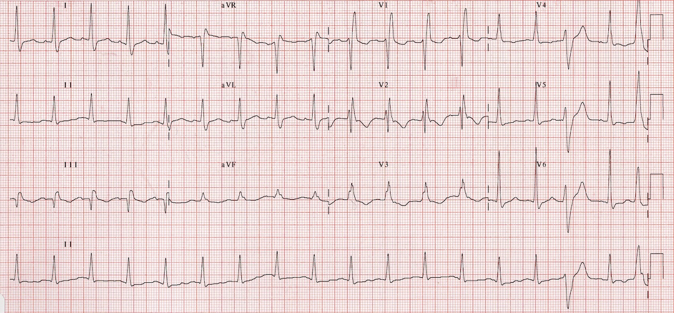
Notes:
•Sinus tachycardia.
•RBBB.
•Simultaneous T-wave inversions in precordial leads V1-3 plus inferior leads III and aVF.

Slide 5
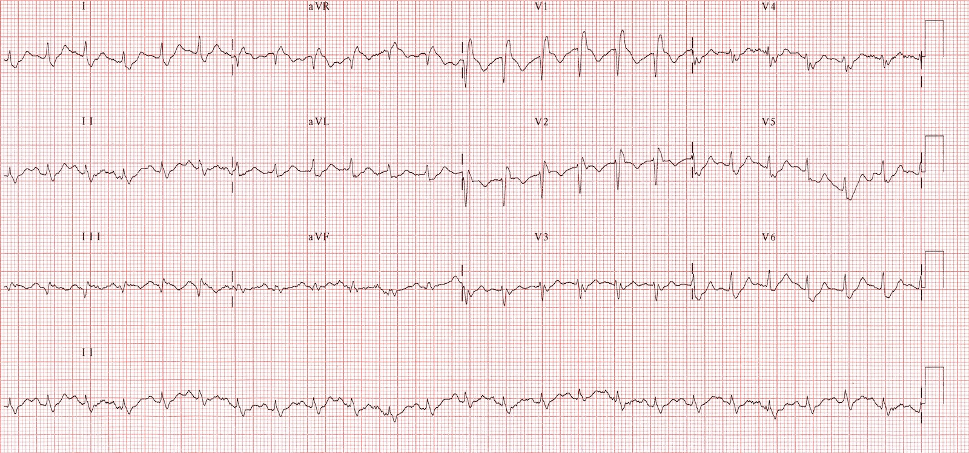
Notes:
•Sinus tachycardia
•RBBB
•T-wave inversions in the right precordial leads (V1-3) as well as lead III

