Slide 1




Patient Simulation

Slide 2
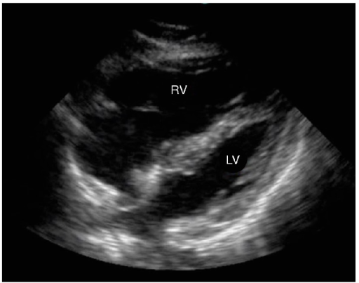

Slide 3
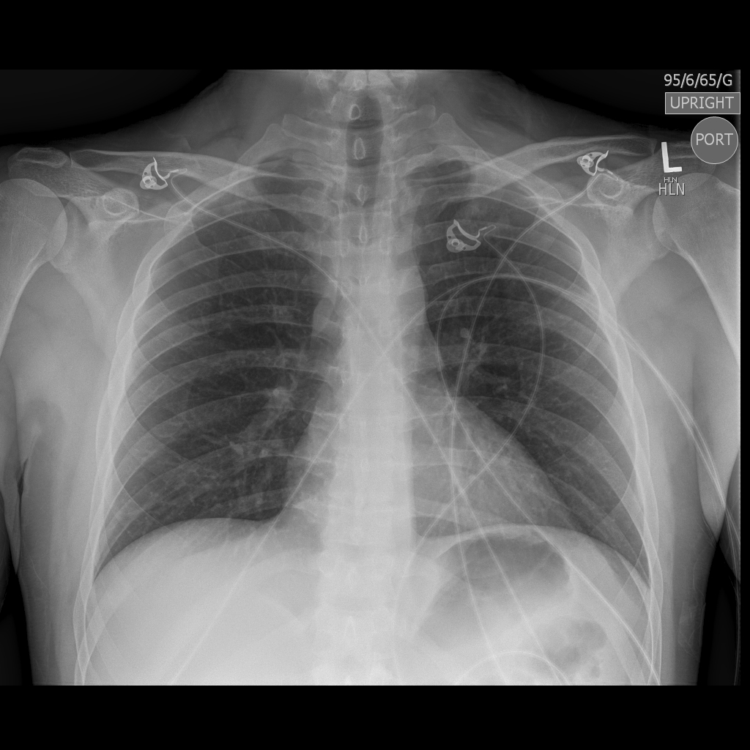

Slide 4
Test |  | Flag (H or L) | Reference
Blood gas
Venous
pH | 7.30 | L | 7.35- 7.45
pCO2 | 30 | L | 35 – 45 mmHg
BE | -1.0 |  | -2.0 to +2.0 mmol/L
HCO3 | 22 |  | 22 – 26 mmol/L
Lactate | 4 | H | 0.7-2.1mmol/L

Slide 5
Test |  | Flag (H or L) | Reference
CBC
WBC | 12 | H | 3.5 – 10.8 10^9/L
RBC | 5 |  | 4.3 – 5.7 10^12/L
Hgb | 130 |  | 130 – 170 g/L
HCT | 0.38 |  | 0.37 – 0.47 L/L
Platelets | 200 |  | 150 – 400 10^9/L
Chemistry
Na | 140 |  | 137 – 145 mmol/L
K | 3.9 |  | 3.5 – 5.0 mmol/L
Cl | 100 |  | 98 – 107 mmol/L
HCO3 | 22 |  | 22-26 mmol/L
Urea | 6.0 |  | 2.5 – 6.1 mmol/L
Creat | 100 |  | 62 – 106 umol/L
Glucose - Random | 6.5 |  | 3.0 – 11.0 mmol/L
Lactate | 4 | H | 0.9 – 1.8 mmol/L
Troponin | 0.1 | H | <0.03 mcg/L
Coags
INR | 0.9 |  | 0.9 – 1.2
PTT | 30 |  | 28 – 38 s

Slide 6
