Slide 1




Patient Simulation

Slide 2
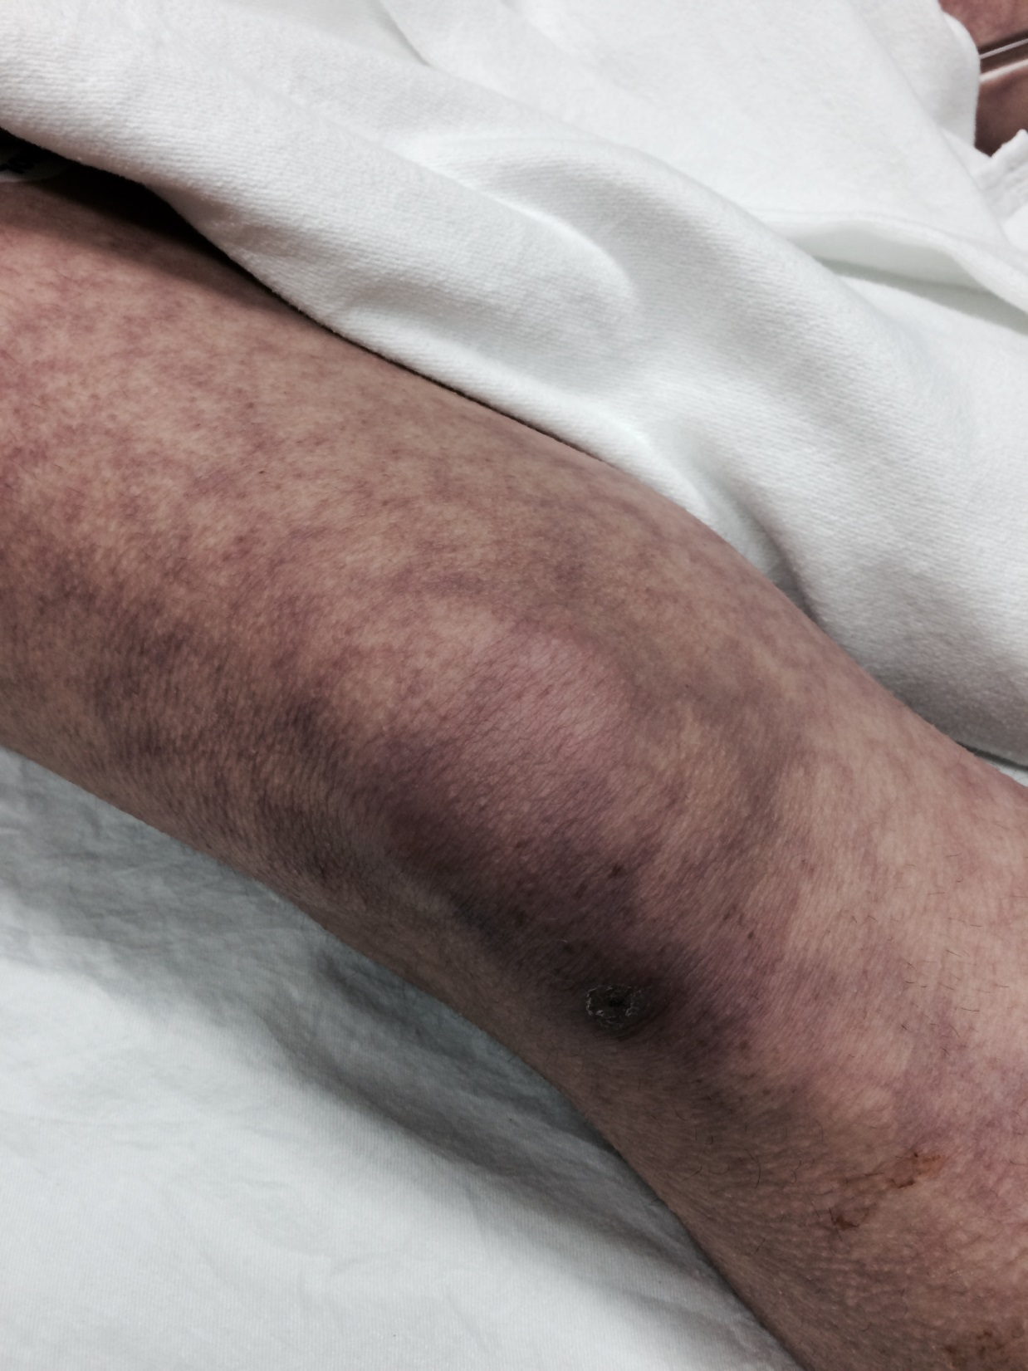

Slide 3
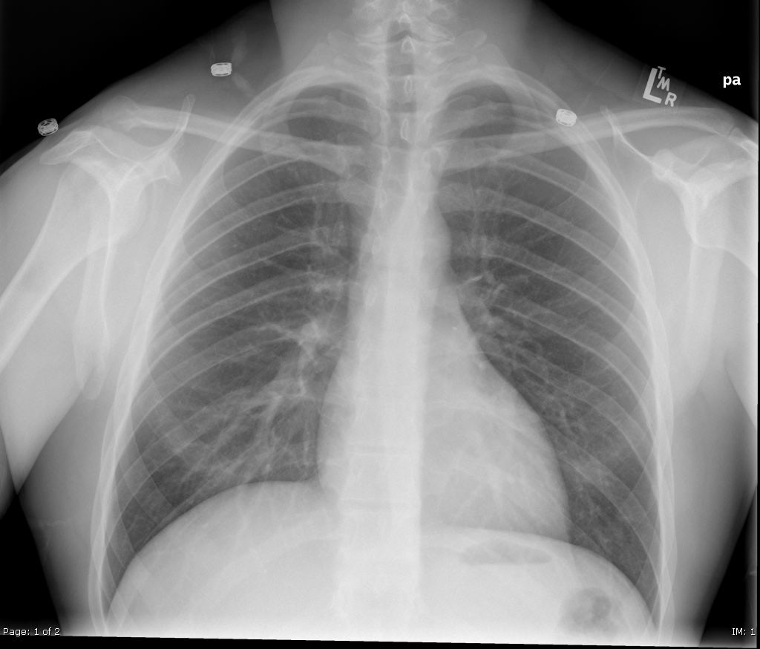
Notes:
Normal CXR

Slide 4
Test | On Admission | Postop Day 6 | Reference
CBC
WBC | 5.6 | 16.2 H | 3.5 – 10.8 10^9/L
RBC | 4.5 | 3.7 L | 4.3 – 5.7 10^12/L
Hgb | 135 | 102 L | 130 – 170 g/L
HCT | 0.39 L | 0.29 L | 0.37 – 0.47 L/L
Platelets | 210 | 90 L | 150 – 400 10^9/L
LYT
Glucose - Random | 7.2 | 9.6 | 3.0 – 11.0 mmol/L
Na | 142 | 131 L | 137 – 145 mmol/L
K | 3.7 | 5.4 H | 3.5 – 5.0 mmol/L
Cl | 102 | 107 | 98 – 107 mmol/L
HCO3 | 24 | 16 L | 22-26 mmol/L
Urea | 7.2 H | 16 H | 2.5 – 6.1 mmol/L
Creat | 97 | 147 H | 62 – 106 umol/L
GFR Est | 72 | 25 L | > 60 ml/min

Slide 5
ABGs
Arterial
pH | 7.10 | L | 7.35- 7.45
pCO2 | 27 | L | 35 – 45 mmHg
PO2 | 80 |  | 80-100 mmHg
BE | -19.9 | L | -2.0 to +2.0 mmol/L
HCO3 | 16 | L | 22 – 26 mmol/L
O2 Sat | 90 | L | 95 – 100%
Notes:
ABGs- metabolic acidosis with respiratory alkalosis

Slide 6
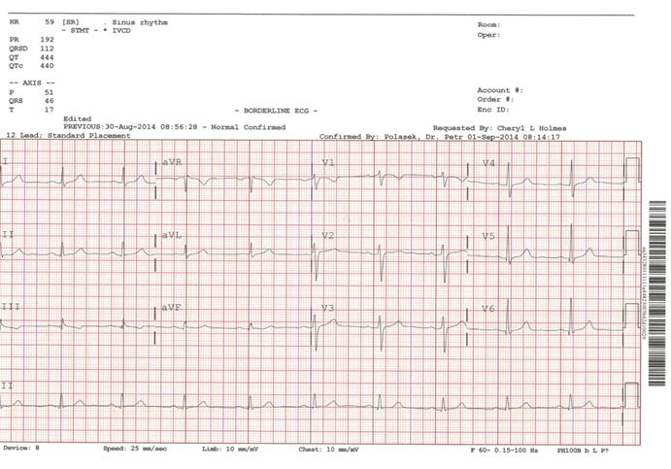

Slide 8
Scroll Up

