Slide 1




Patient Simulation

Slide 2
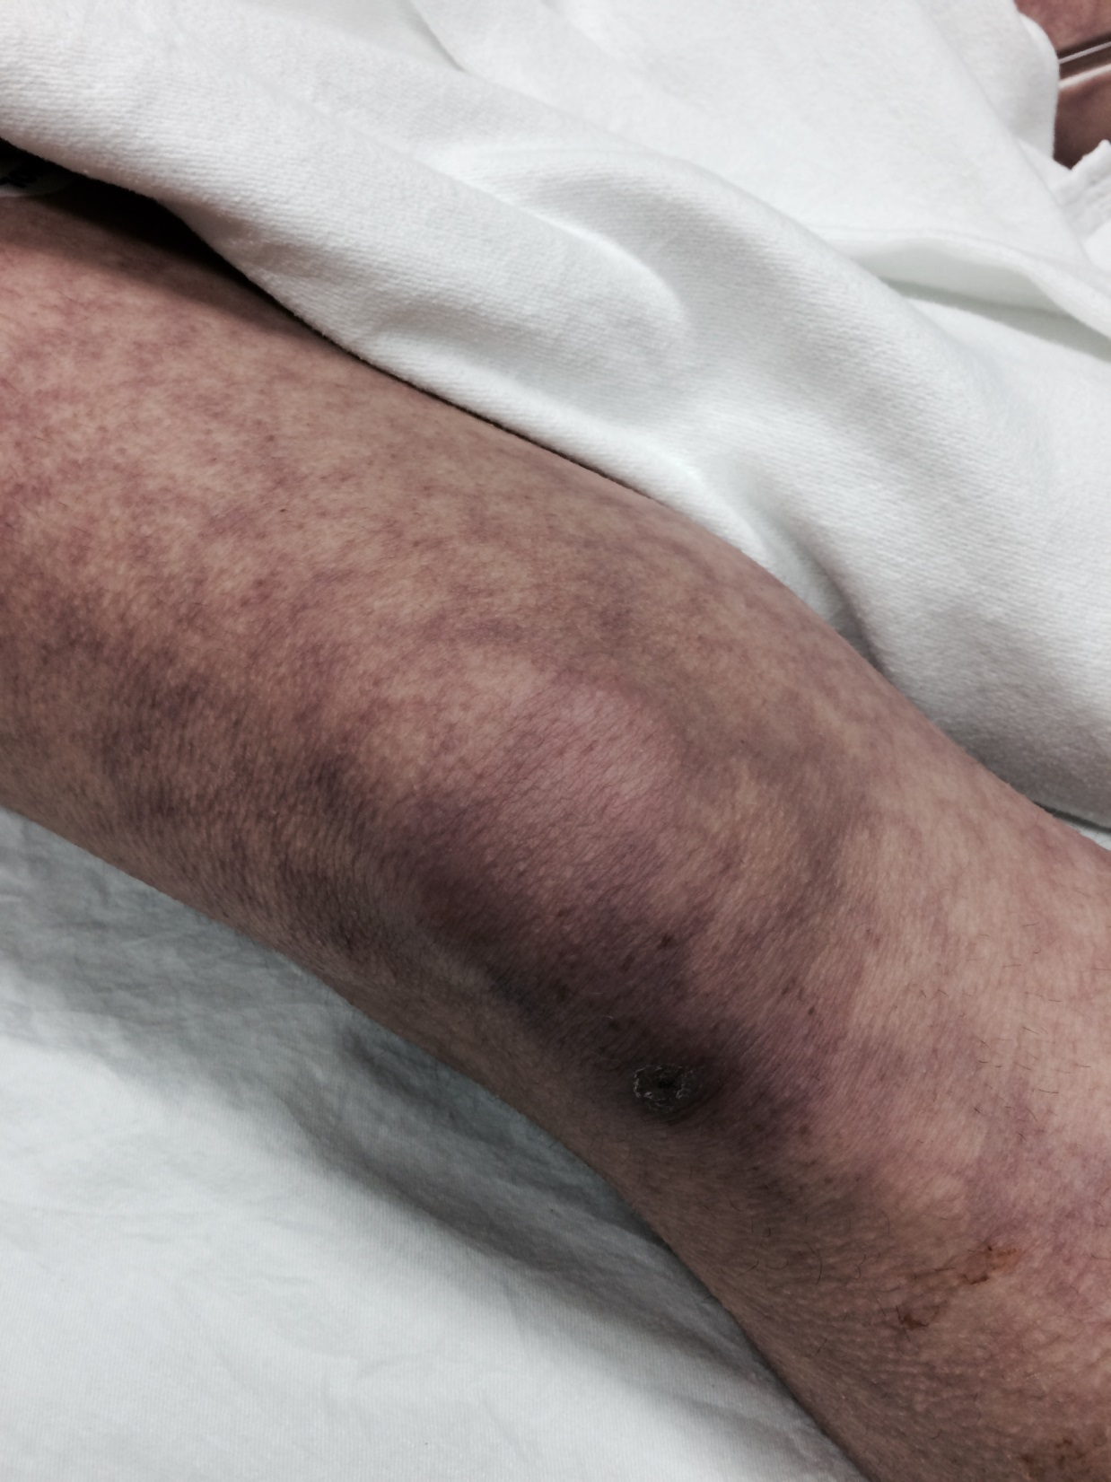

Slide 3
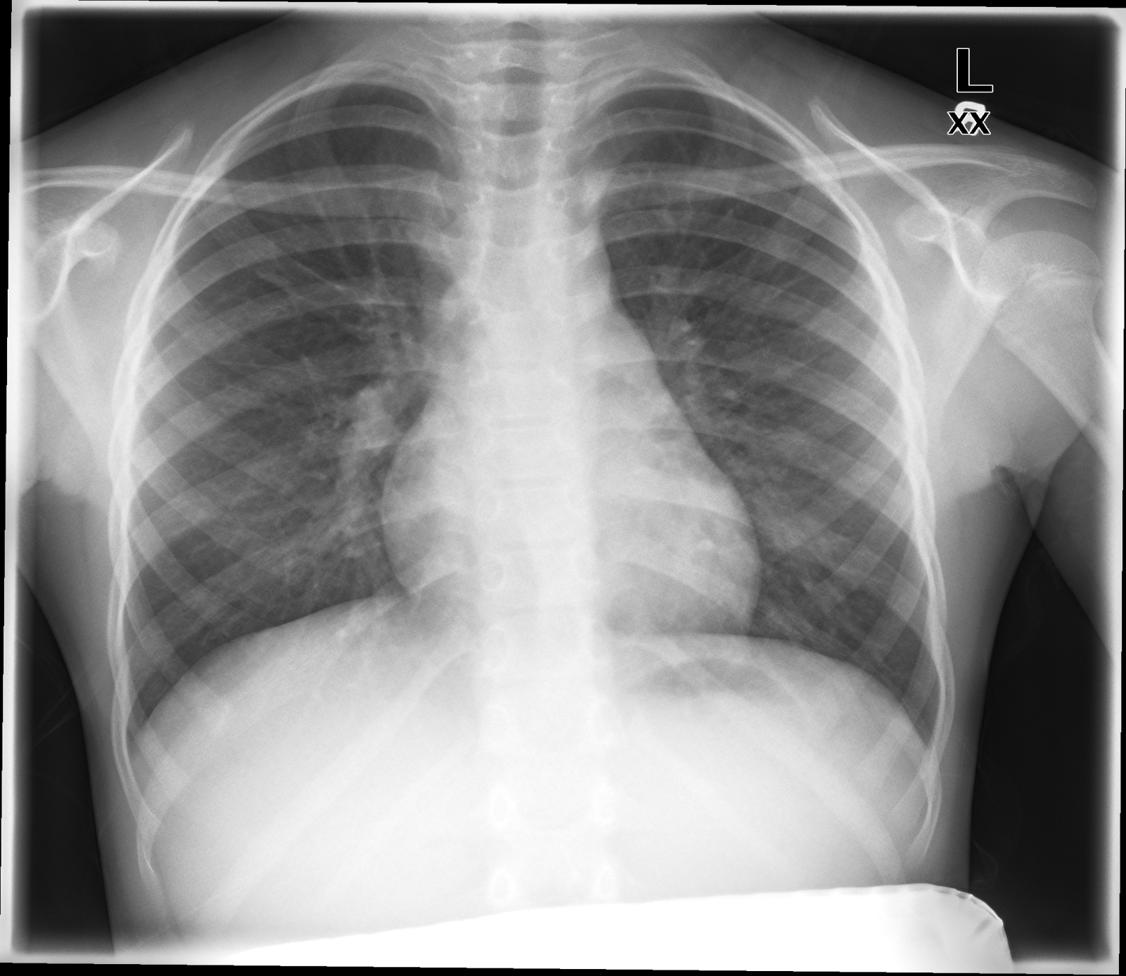

Slide 4
RUN DATE: Today LABORATORY *LIVE* Lab Summary Report
LOCATION
Test | DATE/TIME here | Flag (H or L) | Reference
CBC
WBC | 14.3 | H | 3.5 – 10.8 10^9/L
Hgb | 90 | L | 130 – 170 g/L
Platelets | 332 |  | 150 – 400 10^9/L
Chemistry
Na | 137 |  | 137 – 145 mmol/L
K | 4.6 |  | 3.5 – 5.0 mmol/L
Cl | 103 |  | 98 – 107 mmol/L
HCO3 | 22 |  | 22-26 mmol/L
Creat | 45 | L | 62 – 106 umol/L
GFR Est | 115 | H | > 60 ml/min
Glucose - Random | 8 |  | 3.0 – 11.0 mmol/L
Lactate | 6.0 | H | 0.9 – 1.8 mmol/L
Coags
INR | 1.0 |  | 0.9 – 1.2
PTT | >200 | H | 28 – 38 s
ABGs
Arterial
pH | 7.10 | L | 7.35- 7.45
pCO2 | 40 |  | 35 – 45 mmHg
PO2 | 88 |  | 80-100 mmHg
HCO3 | 19 | L | 22 – 26 mmol/L
O2 Sat | 88 | L | 95 – 100%

Slide 5
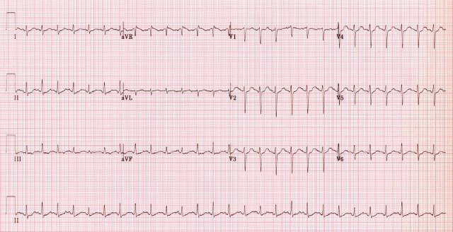

Slide 6
Scroll Up

