Slide 1




Patient Simulation

Slide 2
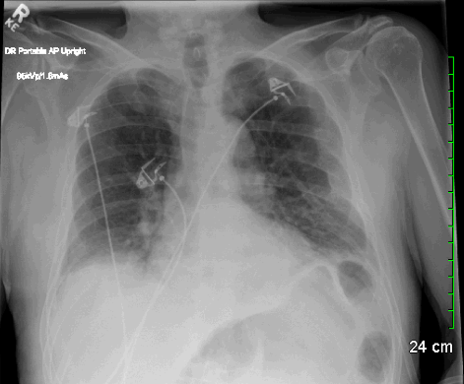

Slide 3
LABORATORY *LIVE* Lab Summary Report
Test | DATE/TIME here | Flag (H or L) | Reference
CBC
WBC | 7.7 |  | 3.5 – 10.8 10^9/L
Hgb | 140 |  | 130 – 170 g/L
Platelets | 350 |  | 150 – 400 10^9/L
Chemistry
Na | 140 |  | 137 – 145 mmol/L
K | 4.5 |  | 3.5 – 5.0 mmol/L
Creat | 80 |  | 62 – 106 umol/L
GFR Est | 90 |  | > 60 ml/min
Glucose - Random | 6.7 |  | 3.0 – 11.0 mmol/L
Troponin | POC 0.02 |  | <0.03 mcg/L

Slide 4
