Slide 1




Patient Simulation

Slide 2
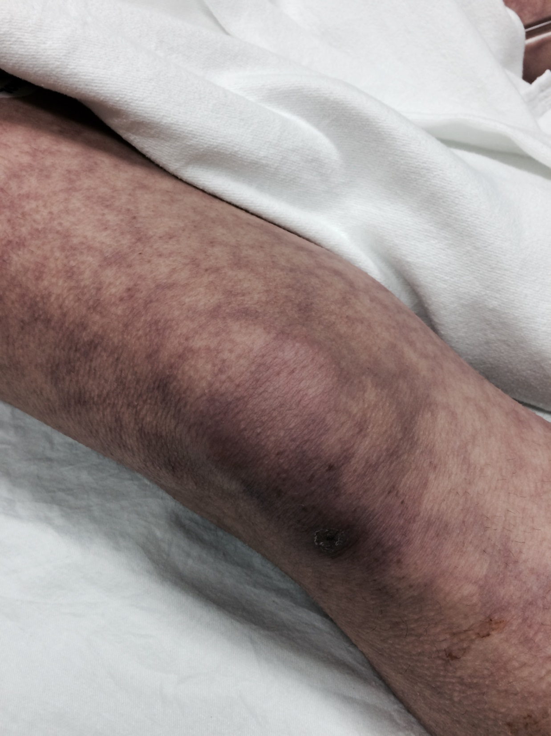

Slide 3
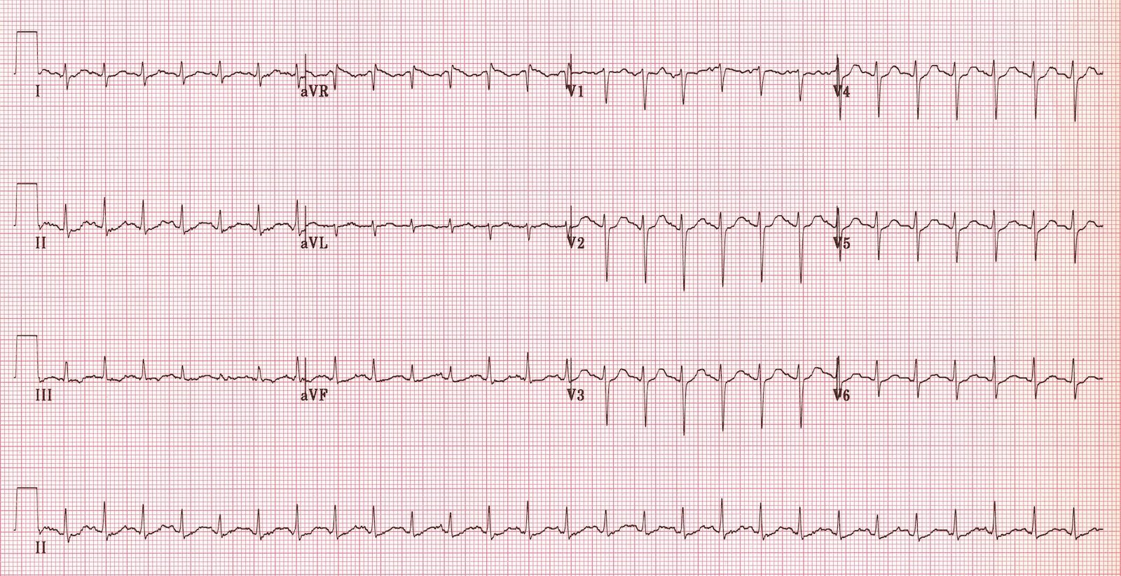

Slide 4
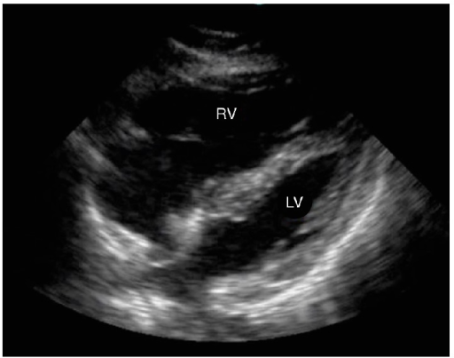
Notes:
Normal CXR

Slide 5
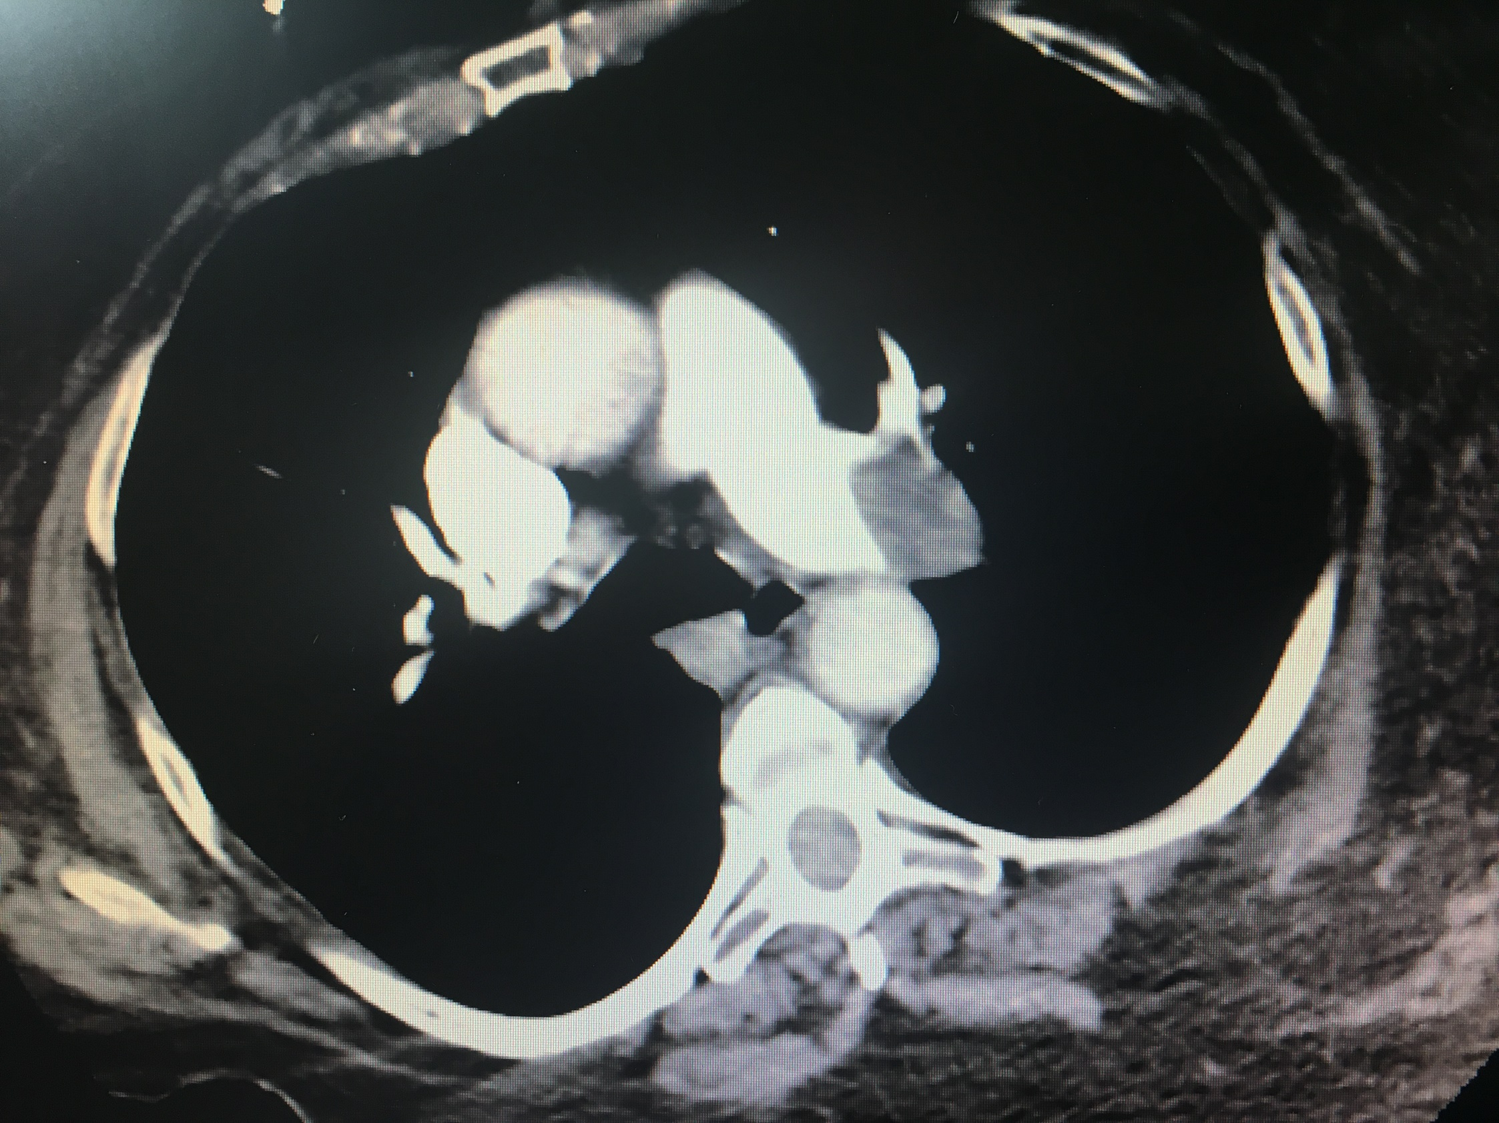

Slide 6
Blood gas
Venous
pH | 6.96 | L | 7.35- 7.45
pCO2 | 44 |  | 35 – 45 mmHg
BE | -21.7 | L | -2.0 to +2.0 mmol/L
HCO3 | 10 | L | 22 – 26 mmol/L
O2 Sat | 98 |  | 95 – 100%
Lactate | 6.1 | H | 0.7-2.1mmol/L

Slide 7
Test | DATE/TIME here | Flag (H or L) | Reference
CBC
WBC | 4.9 |  | 3.5 – 10.8 10^9/L
Hgb | 126 | L | 130 – 170 g/L
Platelets | 200 |  | 150 – 400 10^9/L
Chemistry
Na | 136 | L | 137 – 145 mmol/L
K | 3.9 |  | 3.5 – 5.0 mmol/L
HCO3 | 11 | L | 22-26 mmol/L
Urea | 6.3 | H | 2.5 – 6.1 mmol/L
Creat | 66 |  | 62 – 106 umol/L
GFR Est | 86 |  | > 60 ml/min
Glucose - Random | 36.6 | H | 3.0 – 11.0 mmol/L
Lactate | 6 | H | 0.9 – 1.8 mmol/L
Troponin | 0.27 | H | <0.03 mcg/L
Coags
INR | 0.9 |  | 0.9 – 1.2
PTT | 30 |  | 28 – 38 s
Notes:
ABGs- metabolic acidosis with respiratory alkalosis

Slide 8
Scroll Up

