Slide 1




Patient Simulation

Slide 2
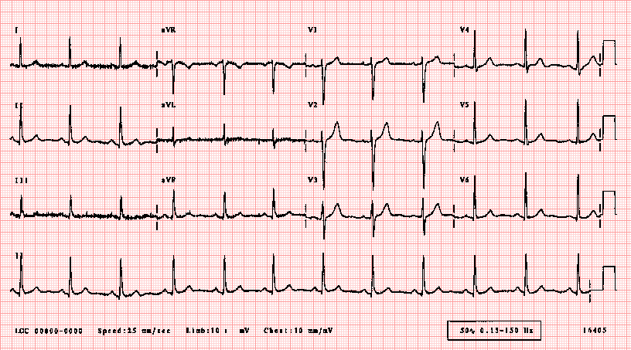

Slide 4
LABORATORY *LIVE* Lab Summary Report
Test | 27/02/2016 0800 | Flag | Reference
CBC
WBC | 24.2 | H | 3.5 – 10.8 10^9/L
Hgb | 145 |  | 130 – 170 g/L
Platelets | 460 | H | 150 – 400 10^9/L

Slide 5
Test | 27/02/2016 0800 | Flag | Reference
Chemistry
Na | 140 |  | 137 – 145 mmol/L
K | 4.0 |  | 3.5 – 5.0 mmol/L
Cl | 100 |  | 98 – 107 mmol/L
HCO3 | 15 | L | 22-26 mmol/L
Urea | 6.0 |  | 2.5 – 6.1 mmol/L
Creat | 104 |  | 62 – 106 umol/L
Lactate | 3.3 | H | 0.9 – 1.8 mmol/L
CK | 120 |  | 5 – 130 U/L
Troponin | 0.01 |  | <0.03 mcg/L
ALT | 230 | H | 7 - 63 U/L
AST | 200 | H | 8 – 40 U/L
GGT | 654 | H | 10 – 48 U/L
Alkaline phosphatase | 730 | H | 38 - 126 U/L
Bilirubin | 35 | H | <26 umol/L
Lipase | 50 |  | <160 U/L

Slide 6
Test | 27/02/2016 0800 | Flag | Reference
VBGs
Venous
pH | 7.29 | L | 7.30-7.40
pCO2 | 33 | L | 40 – 50 mmHg
HCO3 | 15 | L | 22 – 28 mmol/L

