Slide 1




Patient Simulation

Slide 2
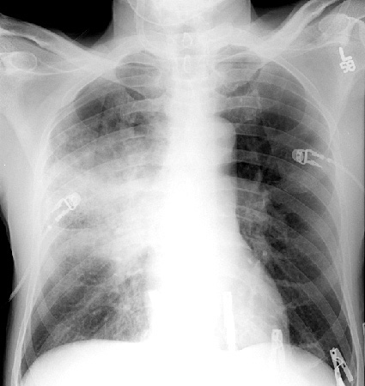

Slide 3
Test | DATE/TIME here | Flag (H or L) | Reference
Venous Blood Gas
pH | 7.18 | L | 7.35- 7.45
pCO2 | 38 |  | 35 – 45 mmHg
PO2 | 124 | H | 80-100 mmHg
HCO3 | 15 | L | 22 – 26 mmol/L
Lactate | 5.1 | H | 0.9 – 1.8 mmol/L

Slide 4
Test | DATE/TIME here | Flag (H or L) | Reference
CBC
WBC | 19.0 | H | 3.5 – 10.8 10^9/L
Neutrophils | 15.0 | H | 2-7 x 10^9/L
Hgb | 104 | L | 130 – 170 g/L
Platelets | 254 |  | 150 – 400 10^9/L
Chemistry
Na | 120 | L | 137 – 145 mmol/L
K | 5.4 | H | 3.5 – 5.0 mmol/L
Cl | 95 |  | 98 – 107 mmol/L
Creat | 181 |  | 62 – 106 umol/L

Slide 5
