Slide 1




Patient Simulation

Slide 2
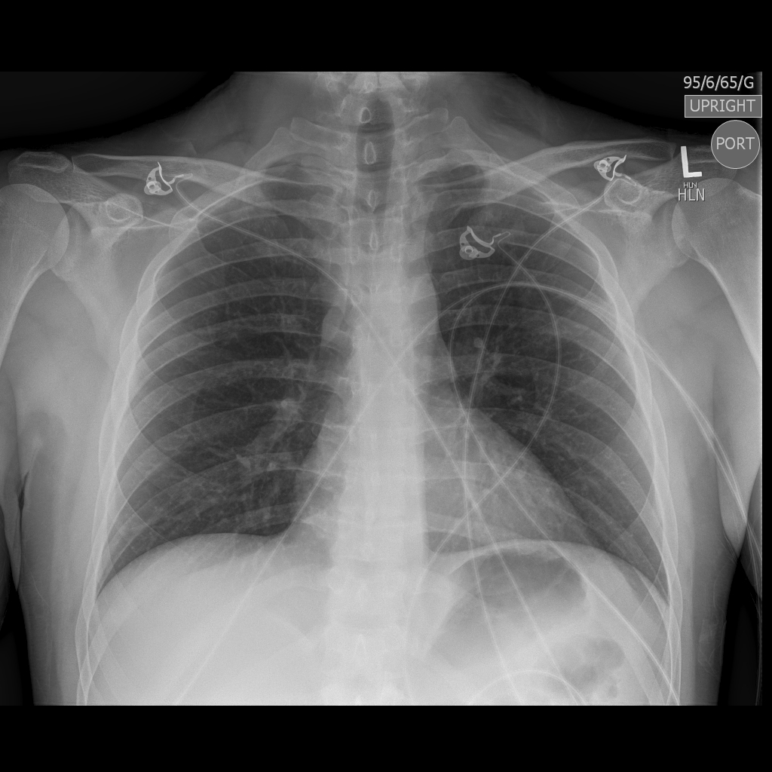

Slide 3
LABORATORY *LIVE* Lab Summary Report
Test | DATE/TIME here | Flag (H or L) | Reference
CBC
WBC | 6.0 | H | 3.5 – 10.8 10^9/L
Hgb | 135 | L | 130 – 170 g/L
Platelets | 200 | H | 150 – 400 10^9/L
Chemistry
Glucose - Random | 15.0 | H | 3.0 – 11.0 mmol/L
Na | 140 |  | 137 – 145 mmol/L
K | 3.3 | L | 3.5 – 5.0 mmol/L
Cl | 102 |  | 98 – 107 mmol/L
HCO3 | 16 | L | 22-26 mmol/L
Urea | 10 | H | 2.5 – 6.1 mmol/L
Creat | 120 | H | 62 – 106 umol/L
GFR Est | 55 | L | > 60 ml/min
Lactate | 5.0 | H | 0.9 – 1.8 mmol/L
Coags
INR | 1.1 |  | 0.9 – 1.2
VBGs
Venous
pH | 7.25 | L | 7.35- 7.45
pCO2 | 30 | L | 35 – 45 mmHg
HCO3 | 16 | L | 22 – 26 mmol/L

Slide 4
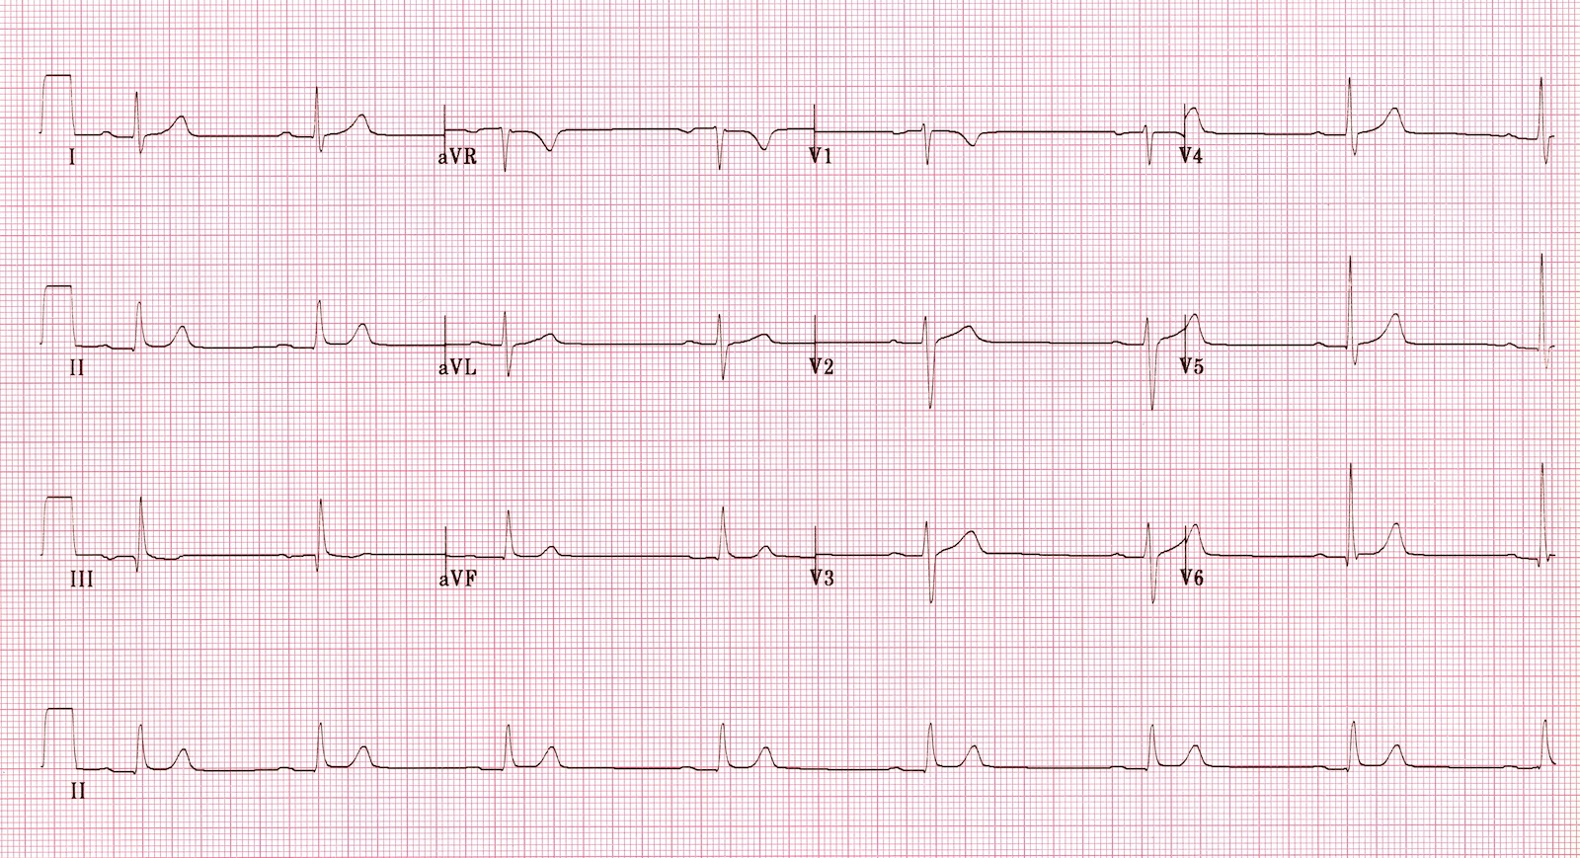

Slide 5
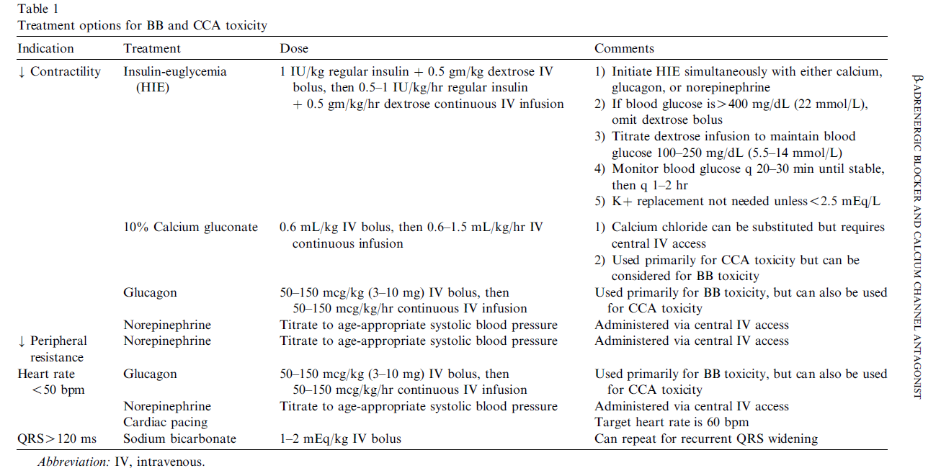
Kerns, W. (2007). Management of beta-adrenergic blocker and calcium channel antagonist toxicity. Emerg Med Clin North Am. May;25(2):309-31.

