Slide 1




Patient Simulation

Slide 2
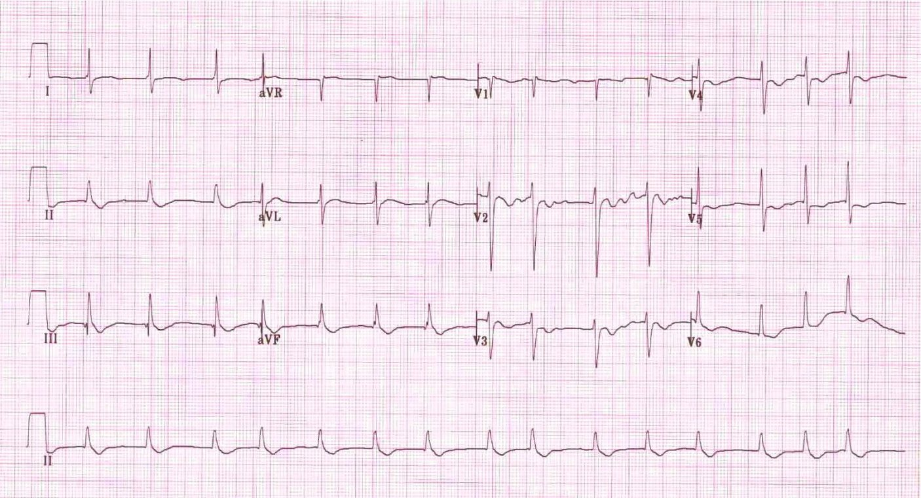

Slide 3
LABORATORY *LIVE* Lab Summary Report
Test | DATE/TIME here | Flag (H or L) | Reference
CBC
WBC | 7.8 |  | 3.5 – 10.8 10^9/L
RBC | 5.2 |  | 4.3 – 5.7 10^12/L
Hgb | 140 |  | 130 – 170 g/L
HCT | 0.40 |  | 0.37 – 0.47 L/L
MCV | 86 |  | 84.0 – 98.0 fL
MCH | 30.1 |  | 28.3 – 33.5 pg
MCHC | 334 |  | 329 – 352 g/L
RDW | 13.0 |  | 12.0/15.0 %
Platelets | 250 |  | 150 – 400 10^9/L
Chemistry
Na | 138 |  | 137 – 145 mmol/L
K | 3.1 | L | 3.5 – 5.0 mmol/L
Cl | 100 |  | 98 – 107 mmol/L
HCO3 | 20 | L | 22-26 mmol/L
GFR Est | 35 | L | > 60 ml/min
Glucose - Random | 8 |  | 3.0 – 11.0 mmol/L
Lactate | 0.9 |  | 0.9 – 1.8 mmol/L
CK | 100 |  | 5 – 130 U/L
Troponin | <0.01 |  | <0.03 mcg/L
Digoxin Level | 8 | H | 1.0.-2.6 nmol/L
Coags
INR | 1.0 |  | 0.9 – 1.2
PTT | 34 |  | 28 – 38 s

