Slide 1




Patient Simulation

Slide 2
LABORATORY *LIVE* Lab Summary Report
Post Arrest labs
Test |  | Date/Time 18/01/17 | Flag (H or L) | Reference
Chemistry
Lactate |  | 15 | H | 0.9 – 1.8 mmol/L
ABGs
Arterial
pH | 6.8 |  | L | 7.35- 7.45
pCO2 | 140 |  | H | 35 – 45 mmHg
PO2 | 60 |  | L | 80-100 mmHg
HCO3 | 5 |  | L | 22 – 26 mmol/L

Slide 3
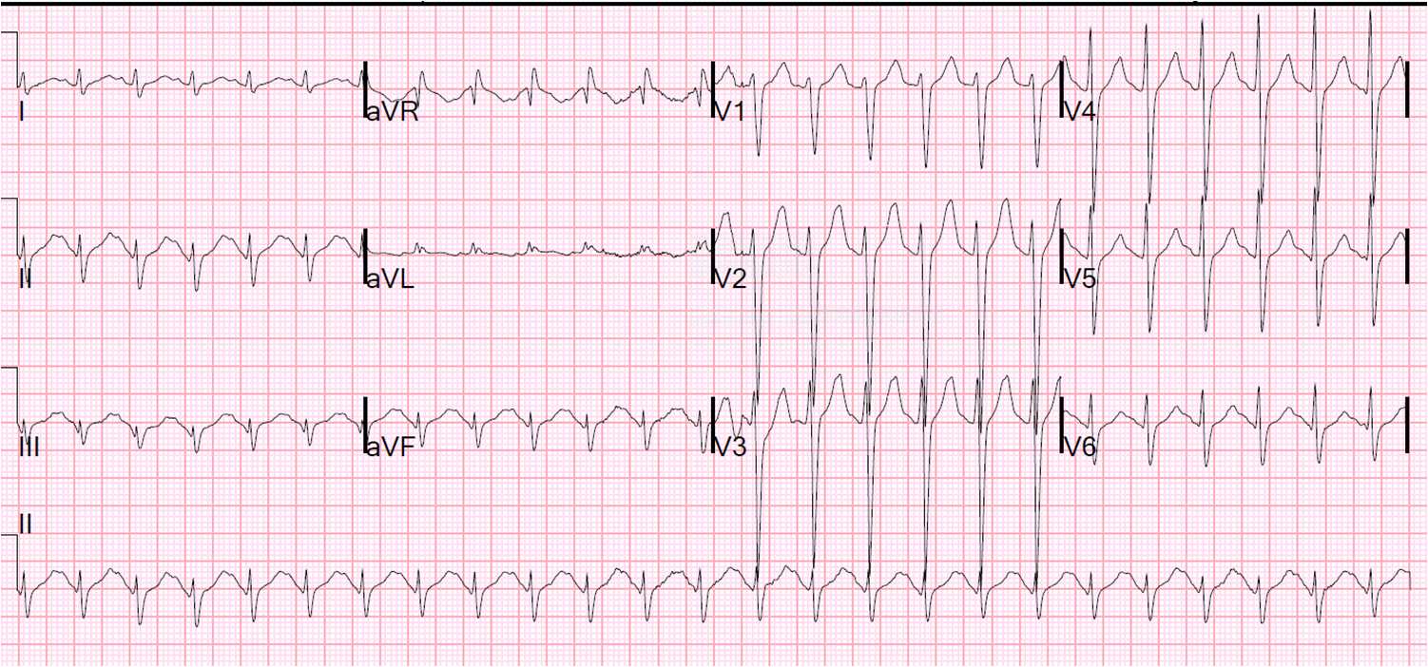

Slide 4
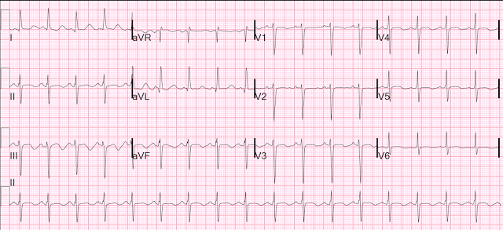

Slide 5
End of Show

