Slide 1




Patient Simulation

Slide 2
https://youtu.be/HfEepVOQrpE
(8:00-9:30 min segment)

Slide 3


Slide 4


Slide 5
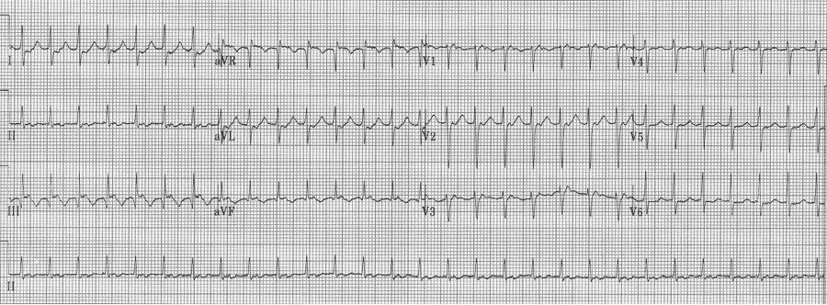

Slide 6
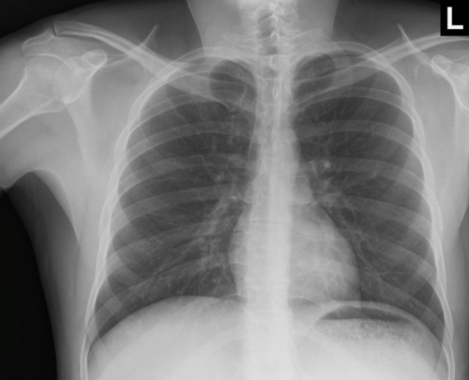

Slide 7
LABORATORY *LIVE* Lab Summary Report
Test | 18/09/2017 0800 | Flag (H or L) | Reference
Blood Gases
Venous
pH | 7.28 | L | 7.35- 7.45
pCO2 | 28 | L | 35 – 45 mmHg
HCO3 | 22 |  | 22 – 26 mmol/L
O2 Sat | 98 |  | 95 – 100%
Lactate | 3.8 | H | 0.7-2.1mmol/L

Slide 8
Test | 18/09/2017 0800 | Flag (H or L) | Reference
CBC
WBC | 10.3 |  | 3.5 – 10.8 10^9/L
Hgb | 136 |  | 130 – 170 g/L
HCT | 0.43 |  | 0.37 – 0.47 L/L
Platelets | 388 |  | 150 – 400 10^9/L
Chemistry
Na | 140 |  | 137 – 145 mmol/L
K | 5.1 | H | 3.5 – 5.0 mmol/L
Cl | 106 |  | 98 – 107 mmol/L
HCO3 | 22 |  | 22-26 mmol/L
Urea | 7.0 | H | 2.5 – 6.1 mmol/L
Creat | 118 | H | 62 – 106 umol/L
Glucose - Random | 5.5 |  | 3.0 – 11.0 mmol/L
EtOH | 5 |  | 0-10 mmol/L
ASA | negative |  | Negative
Acetaminophen | negative |  | Negative
Coags
INR | 1.0 |  | 0.9 – 1.2
PTT |  |  | 28 – 38 s

