Slide 1




Patient Simulation

Slide 2
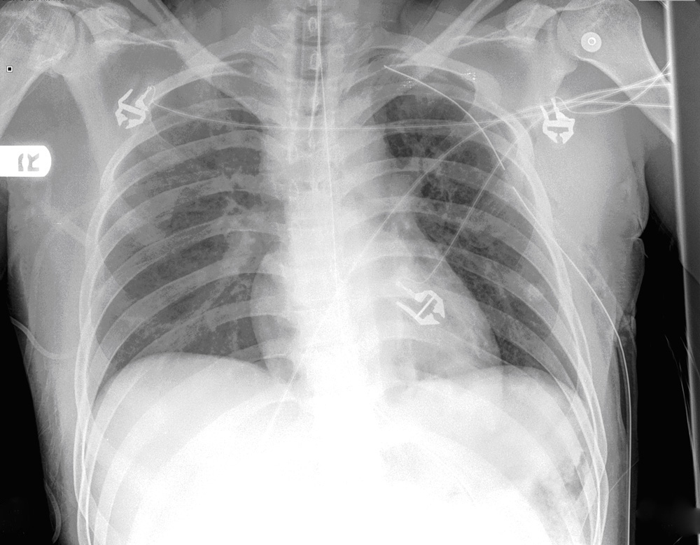
Notes:
Normal CXR

Slide 3
Test | DATE/TIME here | Flag (H or L) | Reference
CBC
WBC | 5.3 |  | 3.5 – 10.8 10^9/L
Hgb | 120 | L | 130 – 170 g/L
HCT | 0.35 | L | 0.37 – 0.47 L/L
Platelets | 236 |  | 150 – 400 10^9/L
Chemistry
Na | 148 | H | 137 – 145 mmol/L
K | 3.4 | L | 3.5 – 5.0 mmol/L
Cl | 109 |  | 98 – 107 mmol/L
HCO3 | 21 | L | 22-26 mmol/L
Urea | 1.6 | L | 2.5 – 6.1 mmol/L
Creat | 60 | L | 62 – 106 umol/L
GFR Est | >120 |  | > 60 ml/min
Glucose - Random | 5.3 |  | 3.0 – 11.0 mmol/L
βHCG | <6 |  | IU/L
Coags
INR | 1.0 |  | 0.9 – 1.2
Blood gas
VBG
pH | 7.32 | L | 7.35- 7.45
pCO2 | 40 |  | 35 – 45 mmHg
BE | -5.2 | L | -2.0 to +2.0 mmol/L
HCO3 | 21 | L | 22 – 26 mmol/L
O2 Sat | 100 |  | 95 – 100%
Lactate | 3.2 | H | 0.7-2.1mmol/L
Notes:
ABGs- metabolic acidosis with respiratory alkalosis

Slide 4
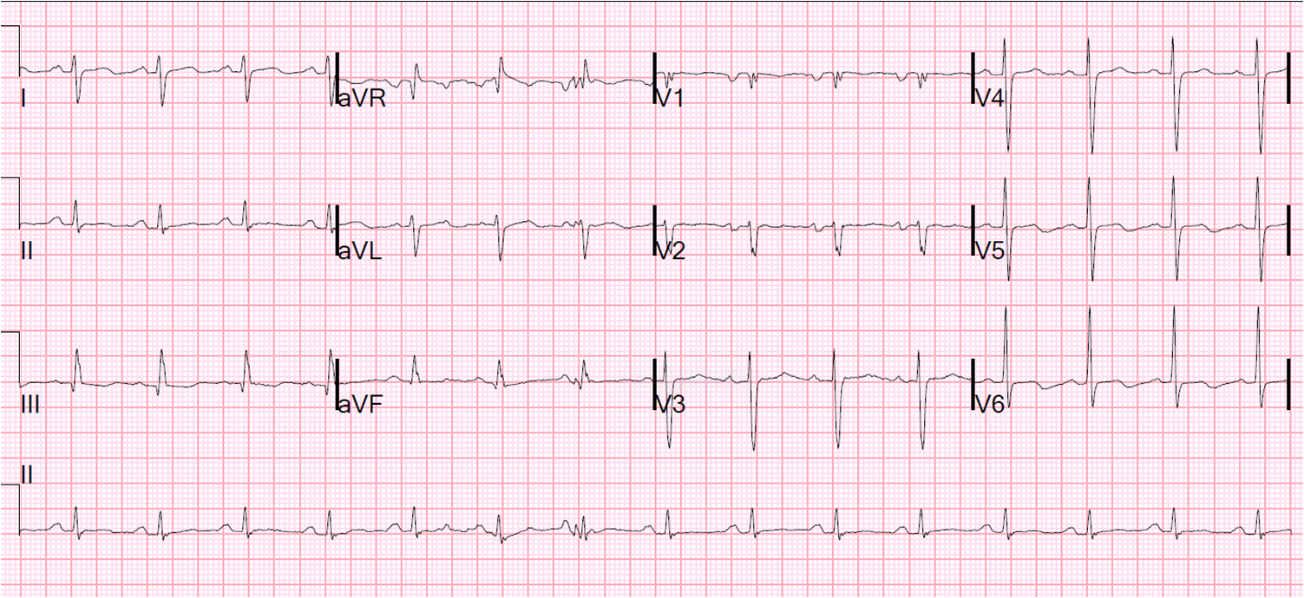

Slide 5
Scroll Up

