Slide 1




Patient Simulation

Slide 3
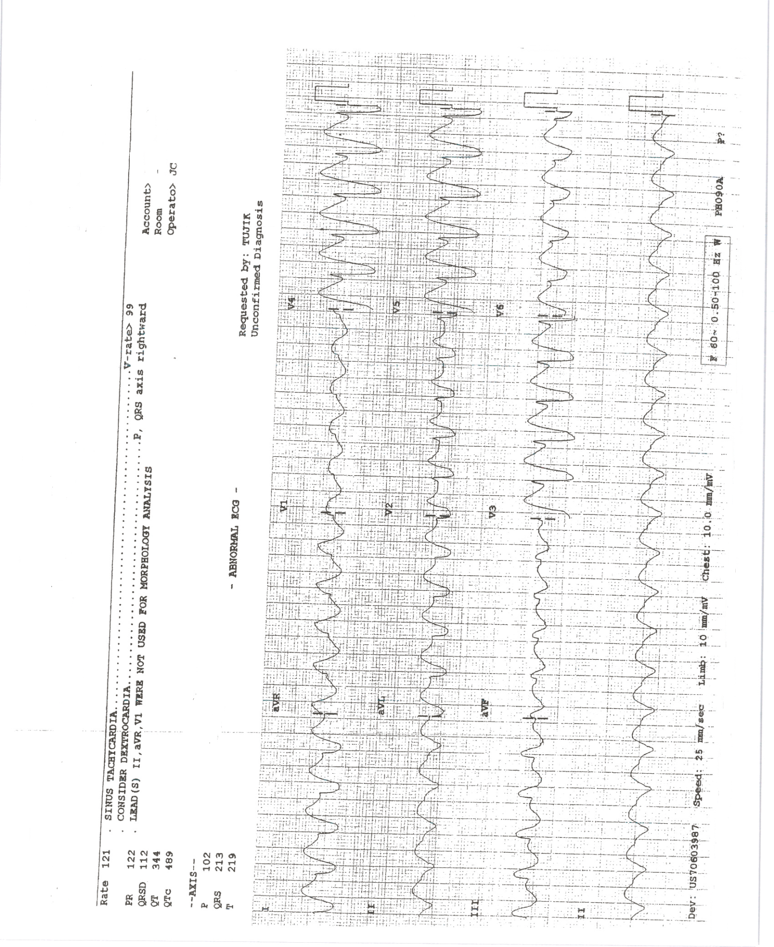

Slide 4
