Slide 1




Patient Simulation

Slide 2
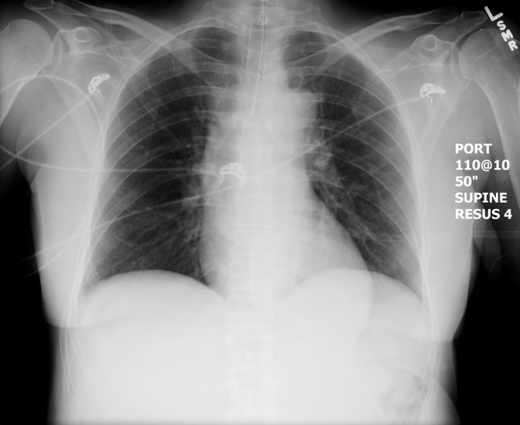

Slide 3
Test | DATE/TIME here | Flag (H or L) | Reference
Venous Blood Gas
pH | 7.10 | L | 7.35- 7.45
pCO2 | 22 | L | 35 – 45 mmHg
PO2 | 45 | L | 80-100 mmHg
HCO3 | 10 | L | 22 – 26 mmol/L
Lactate | 4 | H | 0.9 – 1.8 mmol/L

Slide 4
Test | DATE/TIME here | Flag (H or L) | Reference
Chemistry
Na | 140 |  | 137 – 145 mmol/L
K | 3.7 |  | 3.5 – 5.0 mmol/L
Cl | 105 |  | 98 – 107 mmol/L
HCO3 | 10 | L | 22-26 mmol/L
Urea | 8 | H | 2.5 – 6.1 mmol/L
Creat | 98 |  | 62 – 106 umol/L
Glucose - Random | 6.0 |  | 3.0 – 11.0 mmol/L
Osmo | 339 | H | 280-300 mmol/kg
EtOH | <2
ASA | negative
Tylenol | negative

Slide 5
Test | DATE/TIME here | Flag (H or L) | Reference
CBC
WBC | 13.1 | H | 3.5 – 10.8 10^9/L
Hgb | 136 |  | 130 – 170 g/L
HCT | 0.43 |  | 0.37 – 0.47 L/L
Platelets | 456 | H | 150 – 400 10^9/L

Slide 6
