Slide 1




Patient Simulation

Slide 2
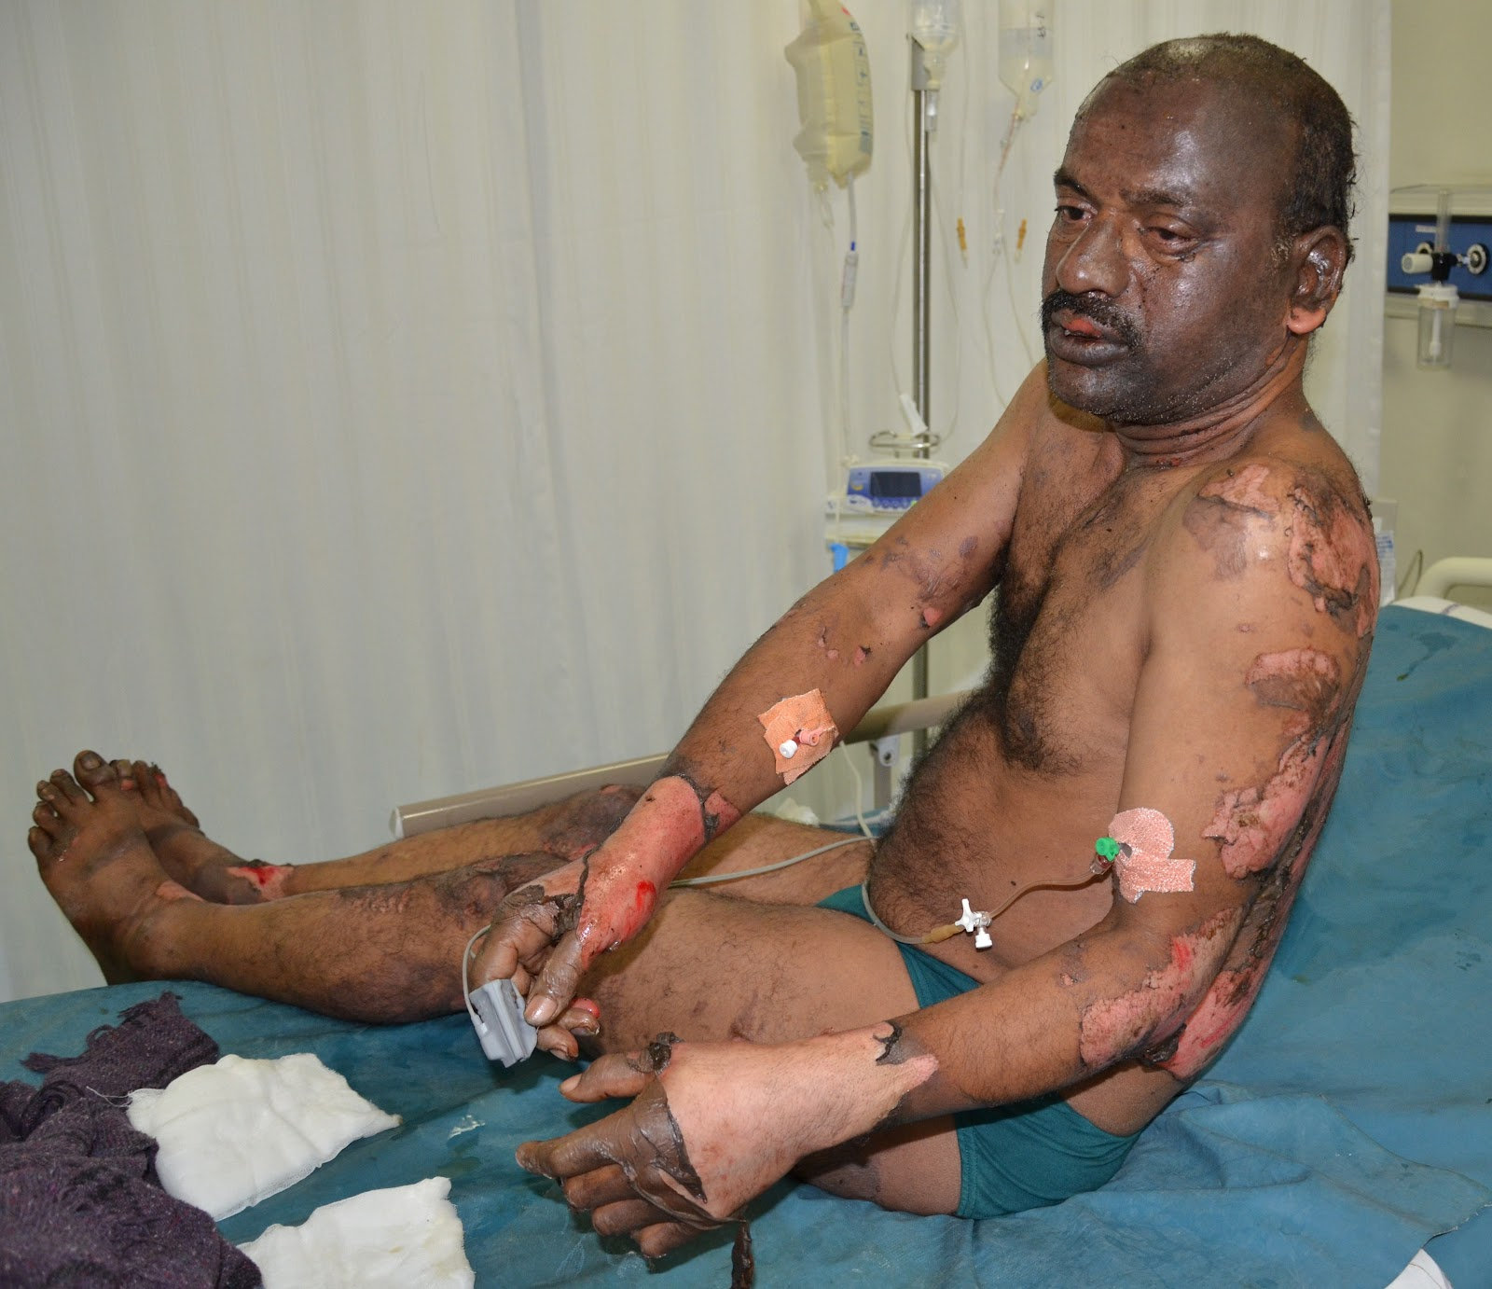

Slide 3
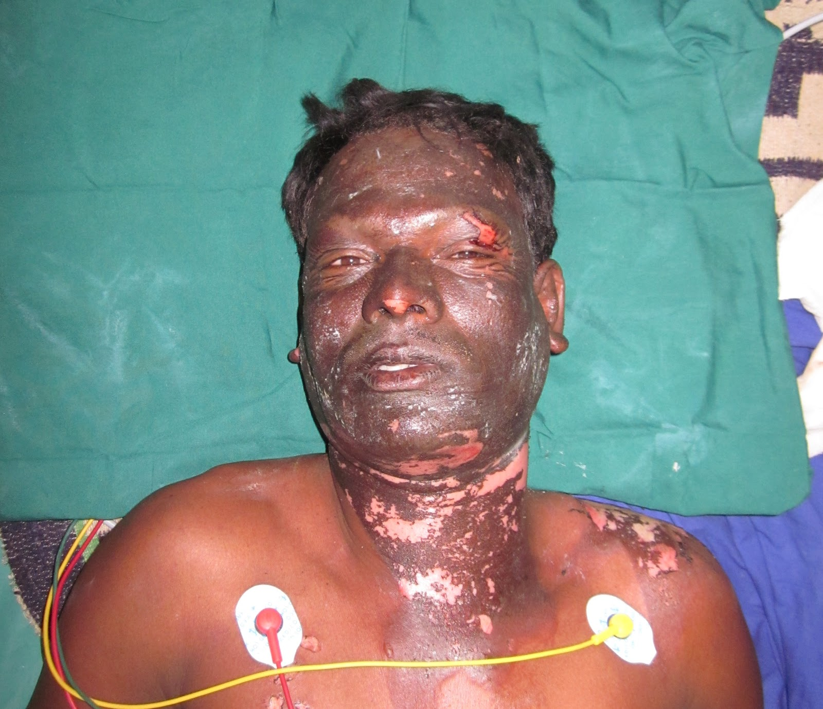

Slide 4
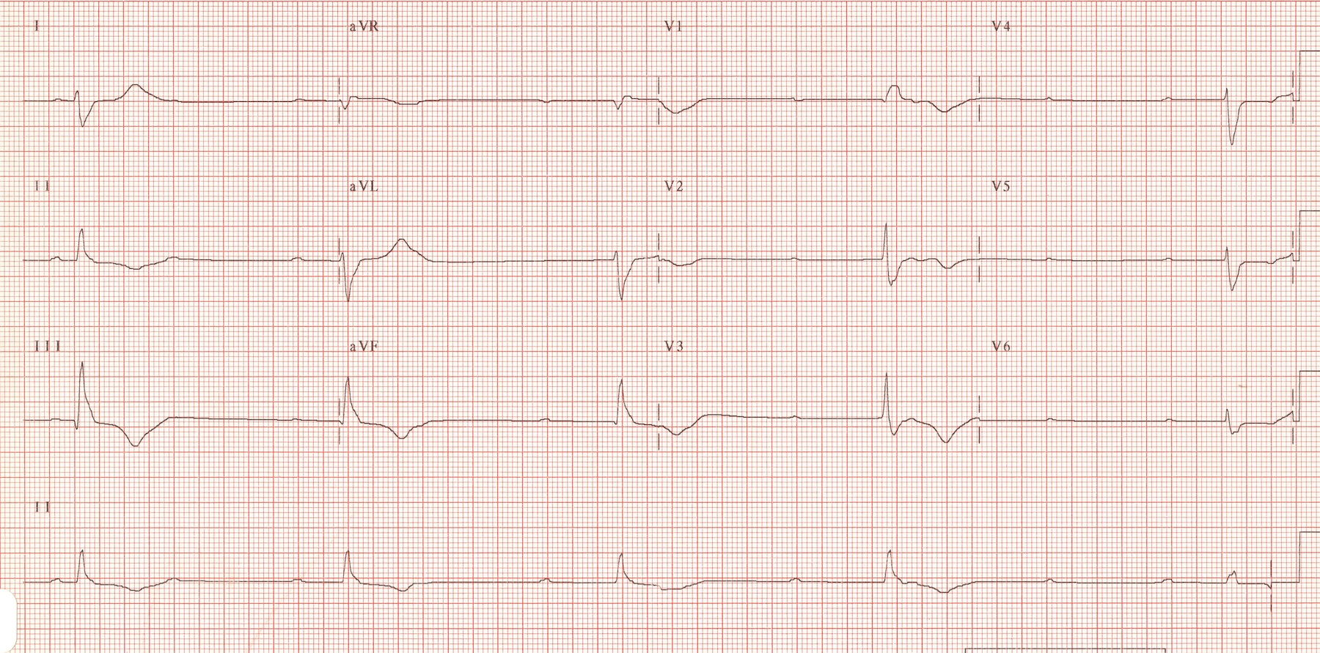

Slide 5


Slide 6
Scroll Up

